Slide 1
GWA Steering Committee April 10, 2024

Slide 2
Today’s Agenda
Overview of DWR’s FSS
Eastern San Joaquin’s Task’s under FSS
Eastern San Joaquin’s previous C&E Plan
Update on Eastern San Joaquin’s C&E Plan
C&E Updated Plan Schedule
Q/A

Slide 3
Meeting Goals
Provide an overview of Eastern San Joaquin’s services to be provided under DWR’s FSS services and initiate the process for the development and work plan for the Communication & Engagement (C&E) Plan Update

Slide 4
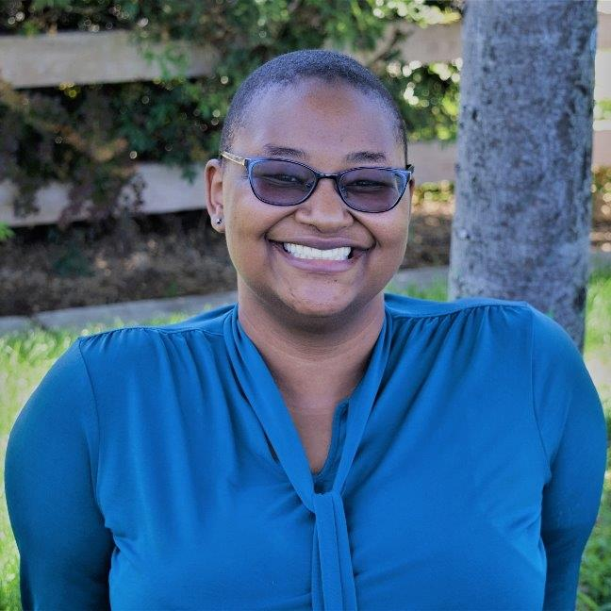
Today’s Presenters
Marina Deligiannis
Lead Facilitator
Khandriale Clark
Associate Facilitator

Slide 5
DWR SGMA Facilitation Support Services
Implementation Service Plan (ISP) Development Process
Step 1
Step 2
Step 3
Step 4
Step 5
GSAs develop FSS program application
DWR reviews application and approves requested services
Stantec and DWR develop FSS scope and budget
DWR reviews and approves final scope and budget
Facilitator begins work
Notes:
The process for acquiring an implementation service plan.

Slide 6
DWR’s FSS Program DOES Cover
Stakeholder assessments
Governance development
C&E planning and support
Public outreach & targeted outreach to underrepresented groups
Tribal engagement
Intra-basin and Inter-basin coordination
Meeting facilitation in service of a particular outcome/goal
Notes:
What FSS does cover.

Slide 7
DWR’s FSS Program DOES NOT Cover
GSA administration, including:
public noticing
website updates
GSA coordination
Facilitation of standing GSA meetings
(e.g., steering committee meetings)
Notes:
What FSS does NOT cover.

Slide 8
Eastern San Joaquin’s ISP-54
Currently being reviewed and approved by DWR
Picks up from previous ISP-27
ISP-54 closeout date of June 30, 2025
4 Main Tasks
Outlines Assumptions & anticipated deliverables for each ISP-54 Task
Notes:
What FSS does NOT cover.

Slide 9
Eastern San Joaquin's FSS Tasks
Task 1: Public Outreach & Coord. Support
C&E Plan Update
Public Meetings (up to 2)
Informational Materials (up to 4)
GSA Website Guidance Document
Interested Parties Database Updates
Notes:
The following tasks denote Stantec’s current budget and scope for facilitation, outreach, and coordination support as provided through the Subbasin’s ISP.
Task 1 includes:
C&E Plan
Revisiting the C&E Framework initially developed (but not completed) during the previous ISP. It will comprise this process initiation meeting where we will review what work has been completed thus far, what the plan hopes to accomplish, and the steps anticipated to get there.
Up to two public meetings for which Stantec will develop facilitation plans, agendas, presentations, and summaries.
Up to four informational materials such as factsheets or newsletters to convey information related to GSP implementation to the general public, specific stakeholder groups, or even governing bodies. The topics of these could include updated FAQs, the 2025 Periodic Update, drought response, and more.
Guidance on an updated web strategy and structure for the GWA and the GSAs for compliance with SGMA’s outreach regulations.
Consolidation of the existing Interested Parties Databases into a more efficient customer relationship management (CRM) software such as MailChimp or Constant Contact. This effort will also include development of separate communications templates for the GWA and GSAs to use for distribution of meeting notices, newsletters, general updates, and more.
REGULATIONS RELEVANT TO SGMA WEB STRATEGY
SGMA and follow-on Emergency Regulations adopted by DWR references but does not explicitly direct GSAs establish and maintain a website. References to agency websites are defined in the following sections of the California Water Code (CWC) and DWR Emergency Regulations:
CWC §10725.2(c) In addition to any other applicable procedural requirements, the groundwater sustainability agency shall provide notice of the proposed adoption of the groundwater sustainability plan on its Internet Web site and provide for electronic notice to any person who requests electronic notification.
§353.6. Initial Notification. (a) Each Agency shall notify the Department, in writing, prior to initiating development of a Plan. The notification shall provide general information about the Agency’s process for developing the Plan, including the manner in which interested parties may contact the Agency and participate in the development and implementation of the Plan. The Agency shall make the information publicly available by posting relevant information on the Agency’s website.
Many other SGMA statues and state regulations further lend themselves to the efficient delivery of communication and engagement actions with interested parties, including public noticing consistent with California’s open meeting laws and the requirement that “each agency establish and maintain a list of persons interested in receiving notices regarding plan preparation, meeting announcements, and availability of draft plans, maps, and other relevant documents. Any person may request, in writing, to be placed on the list of interested persons.” (California Water Code § 10723.4)

Slide 10
Eastern San Joaquin's FSS Tasks
Task 2: Stakeholder Advisory Workgroup
Workgroup Charter
Workgroup Recruitment
Workgroup Meetings (up to 4)

Slide 11
Eastern San Joaquin's FSS Tasks
Task 3: Interbasin Coordination Support
Meetings (up to 3)
Includes adjoining subbasins, such as:
Tracy (5.022-15)
Consumnes (5-022.16)
Modesto (5-021.51)

Slide 12
Eastern San Joaquin's FSS Tasks
Task 4: Contract Management
Monthly progress reporting
Submittal of finalized deliverables

Slide 13
C&E Framework
The Previous Communication and Engagement (C&E) Framework included…
C&E Framework + Attachments
C&E Inventory and Summary
GSA Manager Survey Results and Analysis
Interested Parties Survey Results and Analysis
Website Audit
Example Template Materials
Notes:
The Framework was developed with commitments made, industry best practices, concerns/areas for improvement in mind and as noted in the following documents:
Eastern San Joaquin Subbasin 2022 GSP
Stanislaus County Superior Court: CalSPA v. Interested Persons re Validity of Eastern San Joaquin GSGS Plan (March 16, 2020)
California Department of Water Resources (DWR) GSP Assessment Staff Report (January 28, 2022) – (i.e., notice of determination)
2022–2023 San Joaquin County Grand Jury Report for Case #0622 (June 26, 2023)
The draft document, not able to be completed under the previous ISP, contained a 15 page document accompanied by five attachments.

Slide 14
C&E Framework Key Findings & Recommendations
Communication and Engagement Tracker
Comment Portal
Document Management
Enterprise Management System Transparency
GSP Conformance
Interested Party Database
Notes:
The Framework was developed with commitments made, industry best practices, concerns/areas for improvement in mind and as noted in the following documents:
Eastern San Joaquin Subbasin 2022 GSP
Stanislaus County Superior Court: CalSPA v. Interested Persons re Validity of Eastern San Joaquin GSGS Plan (March 16, 2020)
California Department of Water Resources (DWR) GSP Assessment Staff Report (January 28, 2022) – (i.e., notice of determination)
2022–2023 San Joaquin County Grand Jury Report for Case #0622 (June 26, 2023)
The draft document, not able to be completed under the previous ISP, contained a 15 page document accompanied by five attachments.

Slide 15
C&E Framework Key Findings & Recommendations (cont.)
Native American Heritage Commission
Staff Resources
Website Management
Workgroup
Targeted Outreach
Notes:
The Framework was developed with commitments made, industry best practices, concerns/areas for improvement in mind and as noted in the following documents:
Eastern San Joaquin Subbasin 2022 GSP
Stanislaus County Superior Court: CalSPA v. Interested Persons re Validity of Eastern San Joaquin GSGS Plan (March 16, 2020)
California Department of Water Resources (DWR) GSP Assessment Staff Report (January 28, 2022) – (i.e., notice of determination)
2022–2023 San Joaquin County Grand Jury Report for Case #0622 (June 26, 2023)
The draft document, not able to be completed under the previous ISP, contained a 15 page document accompanied by five attachments.

Slide 16
C&E Framework -> C&E Plan
C&E Plan Objectives:
“Pick up where we left off”
Utilize the work done for C&E Framework
Continue to build from that document and develop a more detailed strategy document
Dive deeper into identified needs with another round of surveying

Slide 17
C&E Plan
C&E Plan Objectives (cont.):
Develop specific points of contact for community partnerships to support outreach and engagement
Provide recommendations for SGMA compliant outreach and engagement with GSA capacity in mind
Prioritize GSA actions and develop organized protocols for engagement
Define roles and responsibilities for GSAs vs GWA

Slide 18
C&E Plan
Next Steps
Determine preferred timeline for completion, goals, and support needed from GSAs and GWA
Further Data Collection (Stakeholder Engagement Survey)
Drafting of C&E Plan

Slide 19
C&E Plan Anticipated Schedule
Survey Contact List – April 30
Stakeholder Engagement Survey – May 3
Survey Approved – May 10
Survey Open – May 13 to 31
Survey Analysis Done – June 14
Draft C&E Plan Done – June 14
GWA Review of Draft Done – June 26
C&E Plan Finalized – June 28

Slide 20
Questions?
Brandon Nakagawa: brandon.nakagawa@ssjid.gov
Marina Deligiannis: Marina.Deligiannis@stantec.com
Khandriale Clark: Khandriale.Clark@stantec.com

