Slide 1
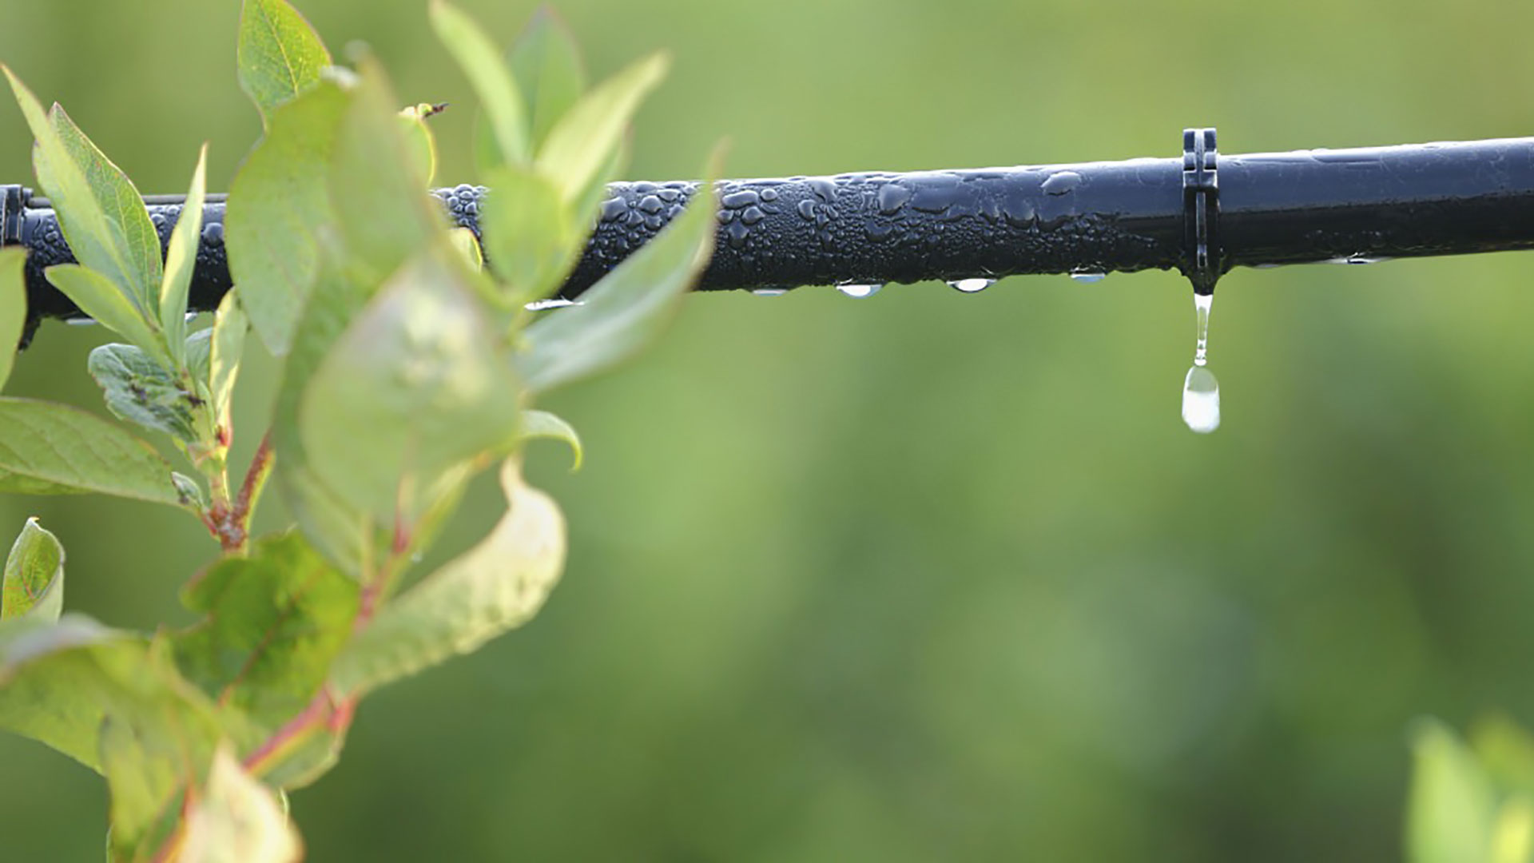
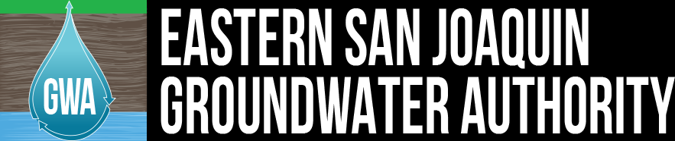
Materials for GSA Outreach
January 2019

Slide 2
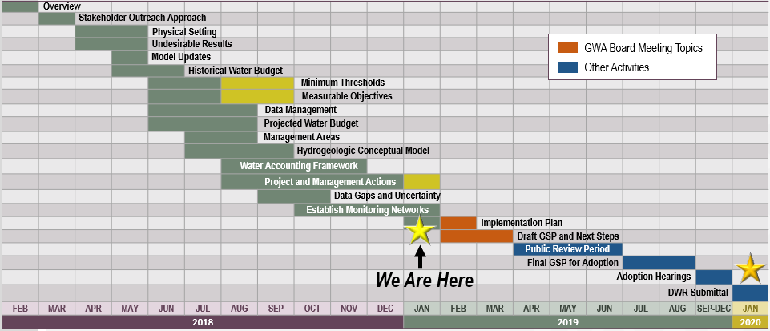
GSP Topics & Project Schedule
GSP Topics
GSP Finalization Elements
2

Slide 3
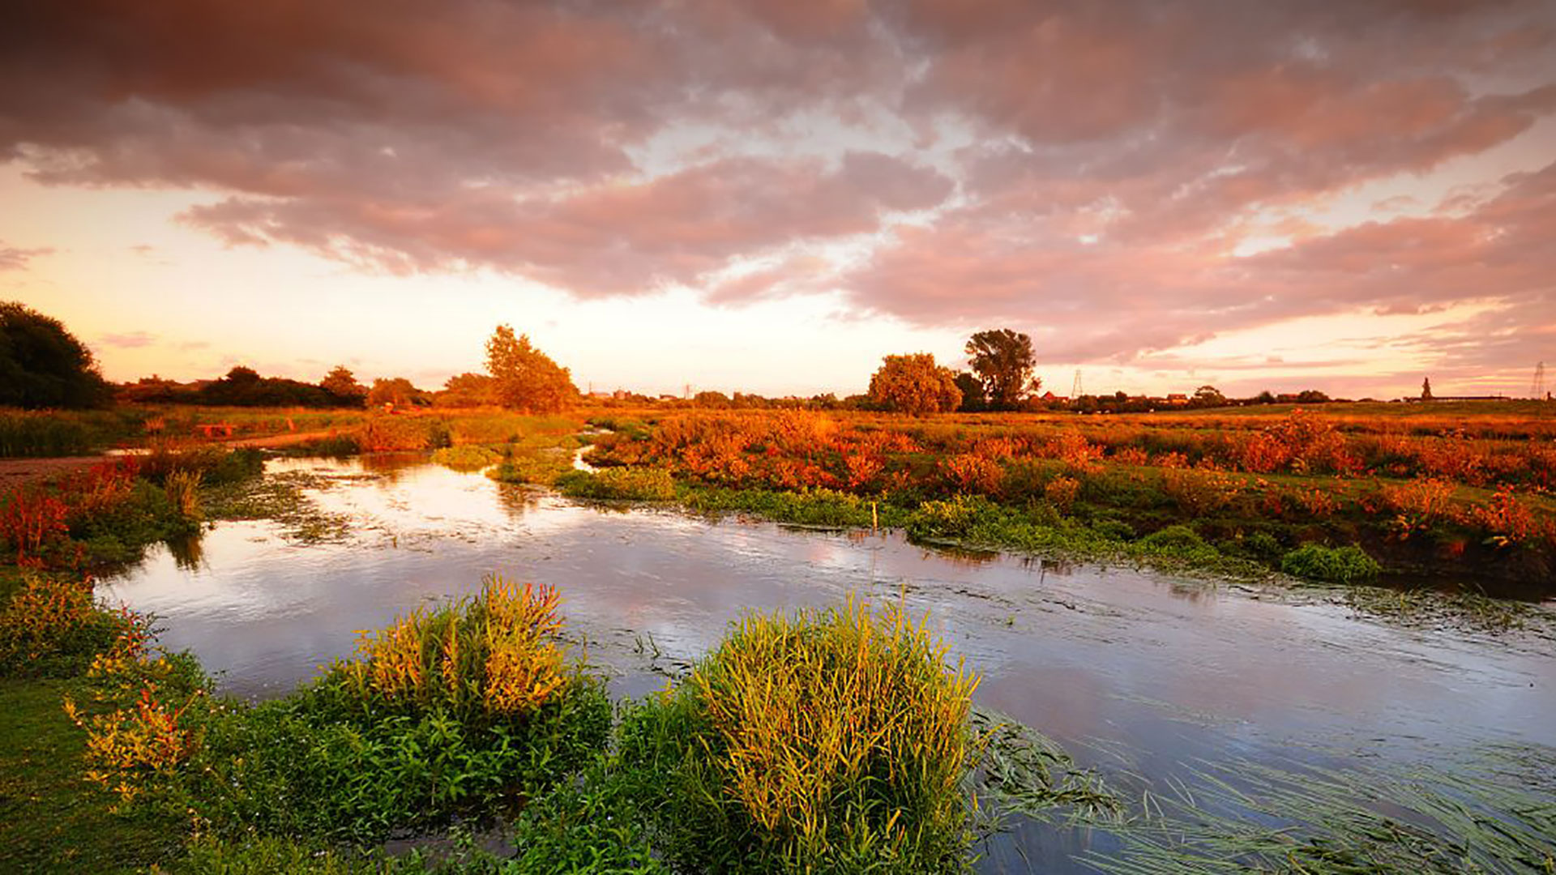
Outreach Update

Slide 4
Groundwater Sustainability Workgroup Update
  7 Workgroup members and 1 member of the public attended the Situation Assessment presentation held on December 12th
  The next Workgroup meeting will be held on January 9th at the San Joaquin County Public Works Department
  Notes from the October Workgroup meeting are available on the website, esjgroundwater.org (under ‘Agendas’ tab)
4

Slide 5
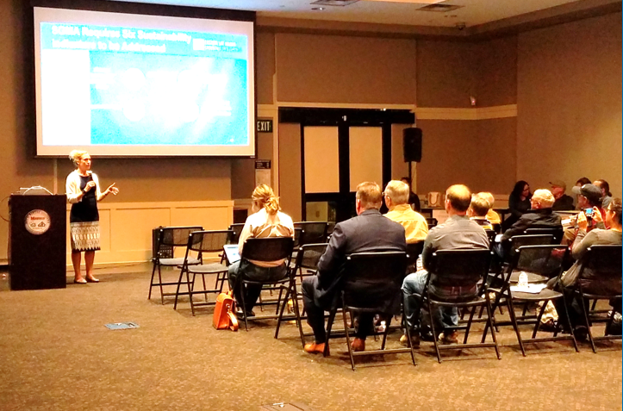
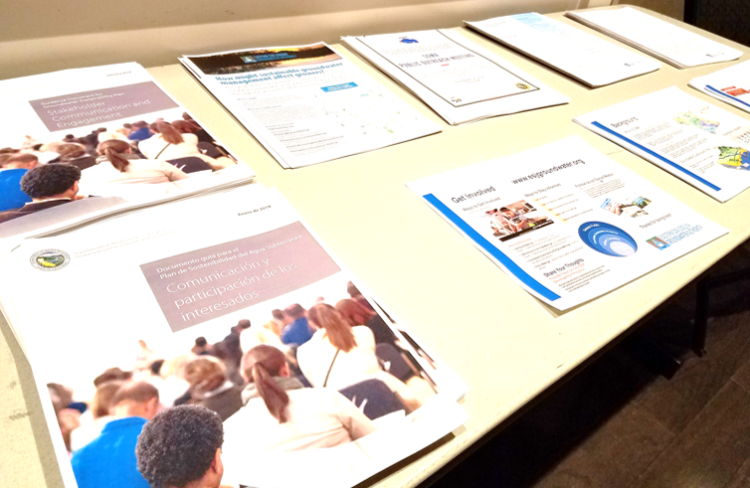
Third Informational Meeting
The third informational meeting/open house will be held in the February timeframe
Additional information will be posted to the website, esjgroundwater.org
5

Slide 6
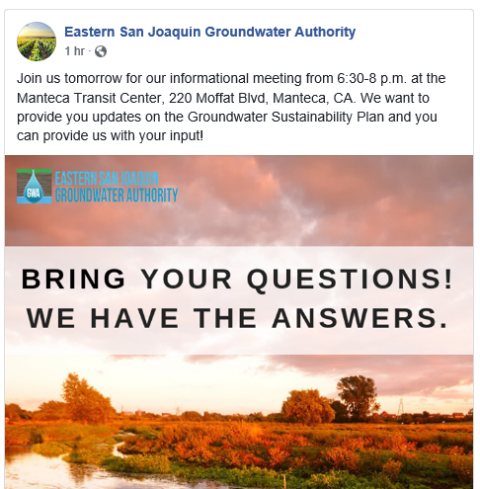

Reminder – The GWA is on Facebook
The ESJ GWA Facebook page provides updates on GSP development and upcoming events
You can like the page, share posts, or tag the page in your own posts
www.facebook.com/ESJGroundwaterAuthority
6

Slide 7

Projects and Management Actions
4

Slide 8
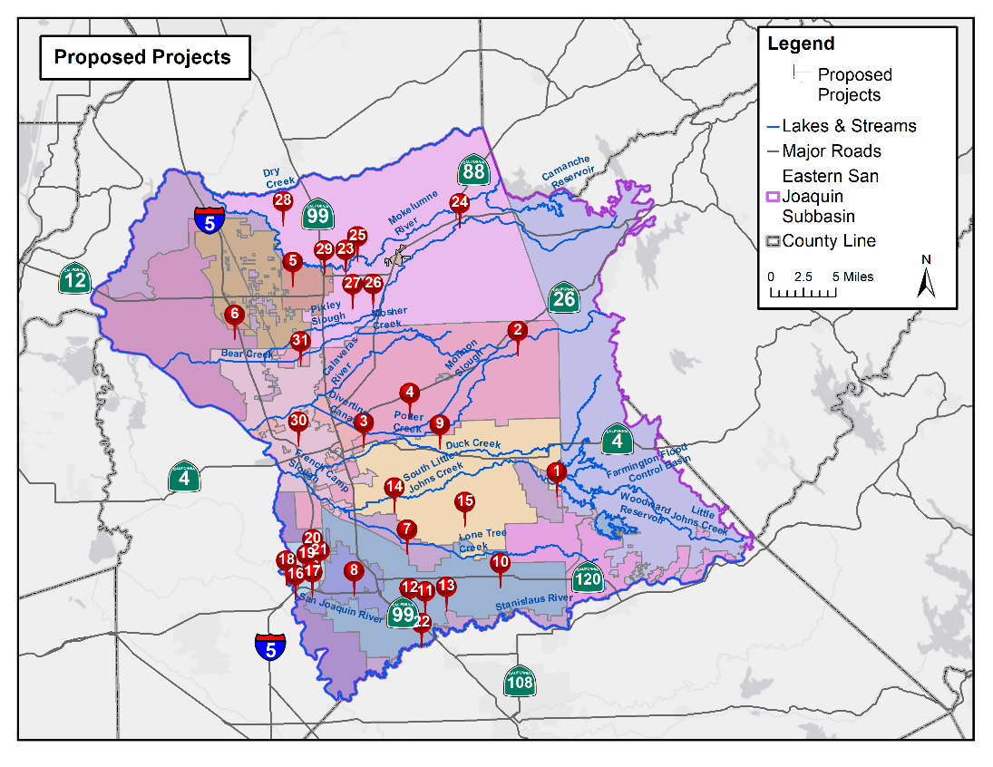
Project Locations
  31 Proposed Projects Received To-Date
  1 – Farmington Dam Repurpose Project
  2 – Lake Grupe In-Lieu Recharge
  3 – Raw Water Reliability and Recharge
  4 – SW Implementation Expansion
  5 – SW Facility Expansion & Delivery Pipeline
  6 – White Slough WPCF Expansion
  7 – Recycled Water Transfer to Agriculture
  8 – Demand Management Measures
  9 – Water Transfers to SEWD and CSJWCD
  10 – Increase Nick DeGroot SW Deliveries
  11 – City of Escalon Wastewater Reuse
  12 – South San Joaquin Stormwater Reuse
  13 – Pressurization of SSJID Facilities
  14 – BNSC Intermodal Facility Recharge Pond
  15 – CSJWCD Capital Improvement
  16 – Recycled Water Program Expansion
  17 – LAS-3 Percolation Basin
  18 – Conjunctive Use of GW and SW
  19 – UWMP Water Conservation
  20 – NPDES Phase 2 MS4 Compliance
  21 – Water Meter Improvements
  22 – City of Ripon Surface Water Supply
  23 – Cal Fed GW Recharge Project
  24 – Mokelumne River Loss Study
  25 – North System Modernization
  26 – PDA Banking
  27 – South System Modernization
  28 – Tracy Lakes GW Recharge
  29 – Winery Recycled Water
  30 – Advanced Metering Infrastructure
  31 – Mobilizing Recharge Opportunities
8

Slide 9
A Range of Project Types are Represented
  Recharge
  Surface Water Supplies (In-Lieu Recharge)
  Water Recycling
  Conservation & Demand Management
  Intra-Basin Transfers
  Stormwater Use
  Technical Studies
9

Slide 10
Projects and Management Actions Will Be Used to Meet Overdraft
Total Water Use
Surface Water
Projected Condition
OVER-DRAFT
Groundwater
Surface Water
Sustainable Condition
Sustainable Groundwater Yield
Projects
10

Slide 11
Pathway to Project Implementation
  1. Approach
  2. Funding
  3. Implementation
  Regional-scale
  Subregional-scale
  GSA-scale
  Regional
  GSA
  Regional JPA
  Subregion GSAs
11

Slide 12
Project Assessment
4

Slide 13
Project Assessment Process
          The Advisory Committee developed and ranked a series of 6 assessment criteria
          Projects were scored against each criterion
          Each GSA was met with individually to confirm project details and review scoring process
13

Slide 14
Assessment Criteria
          Implementability
          Location / Proximity to Area of Overdraft
          Cost per Volume Water Savings
          Environmental Benefit / Impact
          Disadvantaged Community Benefit
          Water Quality Impact (Positive or Negative)
14

Slide 15
Project Portfolios
4

Slide 16
Project Portfolio Development Process
          Workshop was held to identify basin priorities
          Feedback was used to identify 9 portfolio themes to meet the needs of the basin
          Projects were evaluated and compared
          Next Steps:
          Refine/optimize selected portfolios
          Address undesirable results through GSA-scale projects
16

Slide 17
Preliminary Project Portfolios
Preliminary portfolios are being developed to package projects most in line with these criteria:
Cost-Effectiveness
Regional Diversity
Minimized Infrastructure
Environmental Benefit
DAC Benefit
Impact on Cone of Depression
Fast Implementation
Small-Volume Projects
Large-Volume Projects
17

Slide 18
Monitoring Network and TSS Wells

Slide 19
Technical Support Services (TSS) Funding Update
Review: DWR’s Technical Support Services provides funding to construct monitoring wells in areas where data gaps exist
At the November meeting, the GWA Board voted to authorize the Basin Coordinator to submit the TSS application with the 3 identified monitoring well locations
19

Slide 20
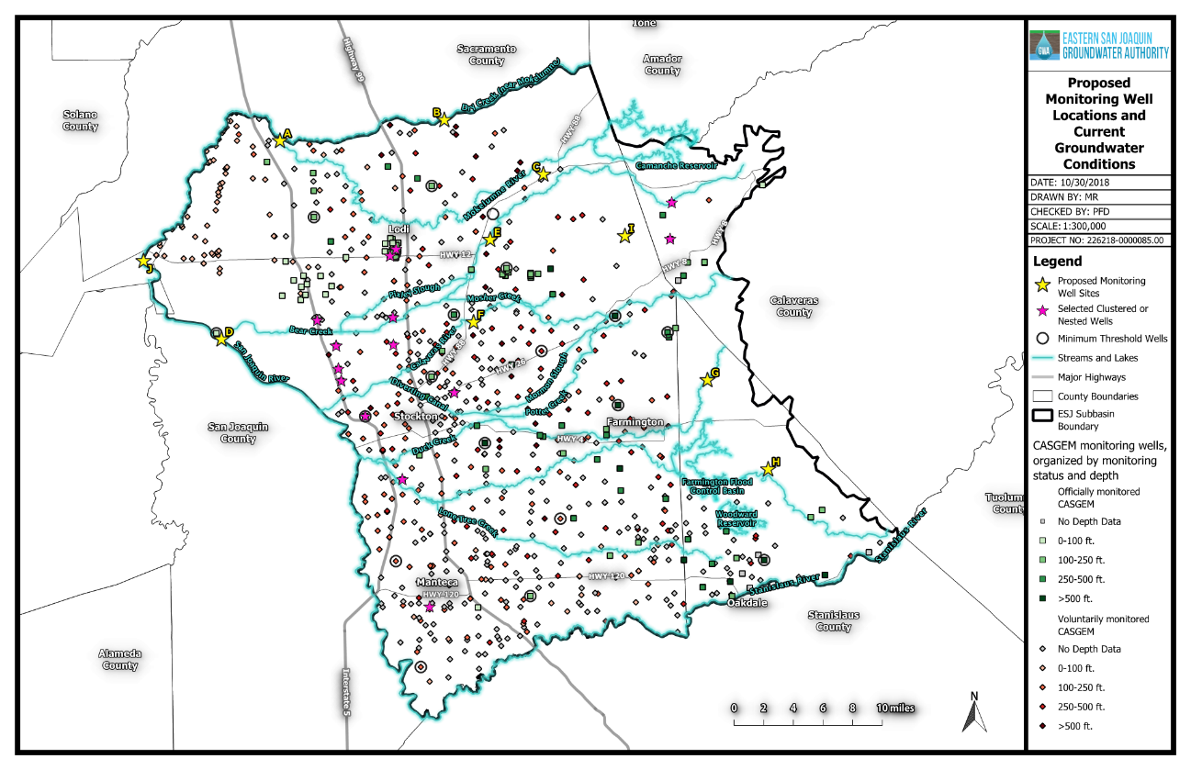
3 Locations Identified for TSS Wells
Dry Creek
Surface water interaction
Potential GDEs
Cosumnes Subbasin
Low GW levels
These locations were recommended based on their ability to assess sustainability and support future projects
Calaveras/Hwy 88
Surface water interaction
Low GW levels
Duck Creek/Stan. Co.
No nearby wells
Surface water interaction
Potential GDEs
Shallow / low cost site
20

