Slide 1
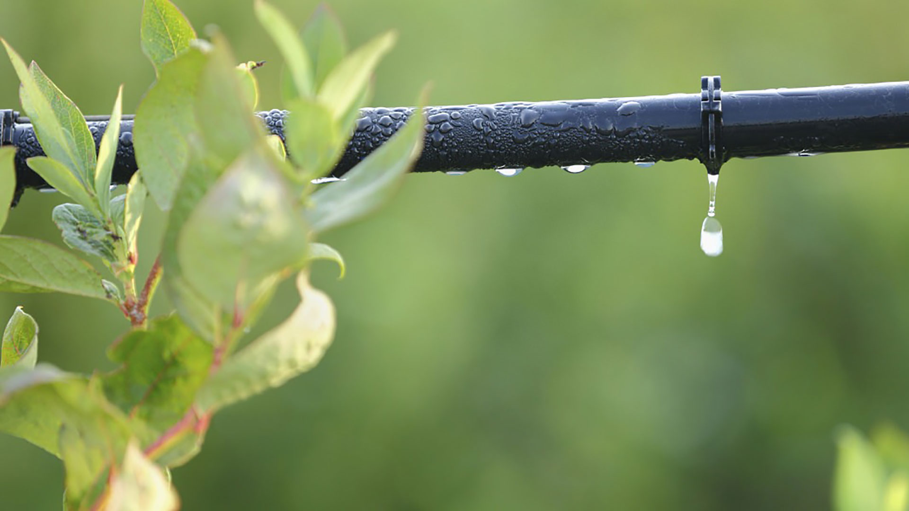
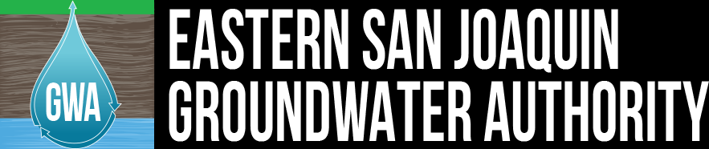
Materials for GSA Outreach
September 2018

Slide 2
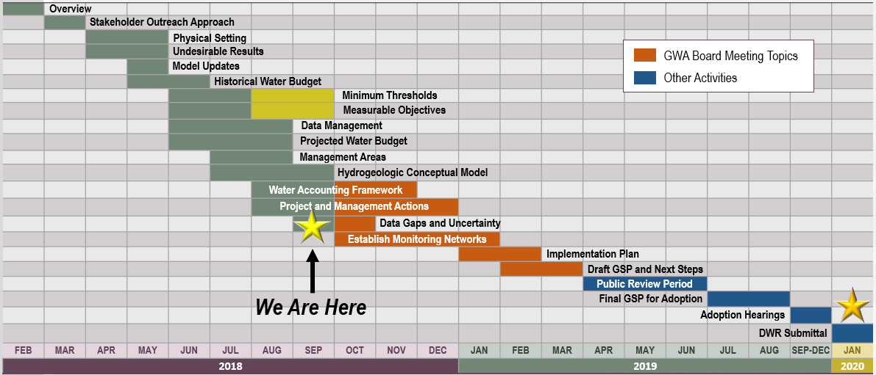
GSP Topics & Project Schedule
GSP Topics
GSP Finalization Elements
2

Slide 3
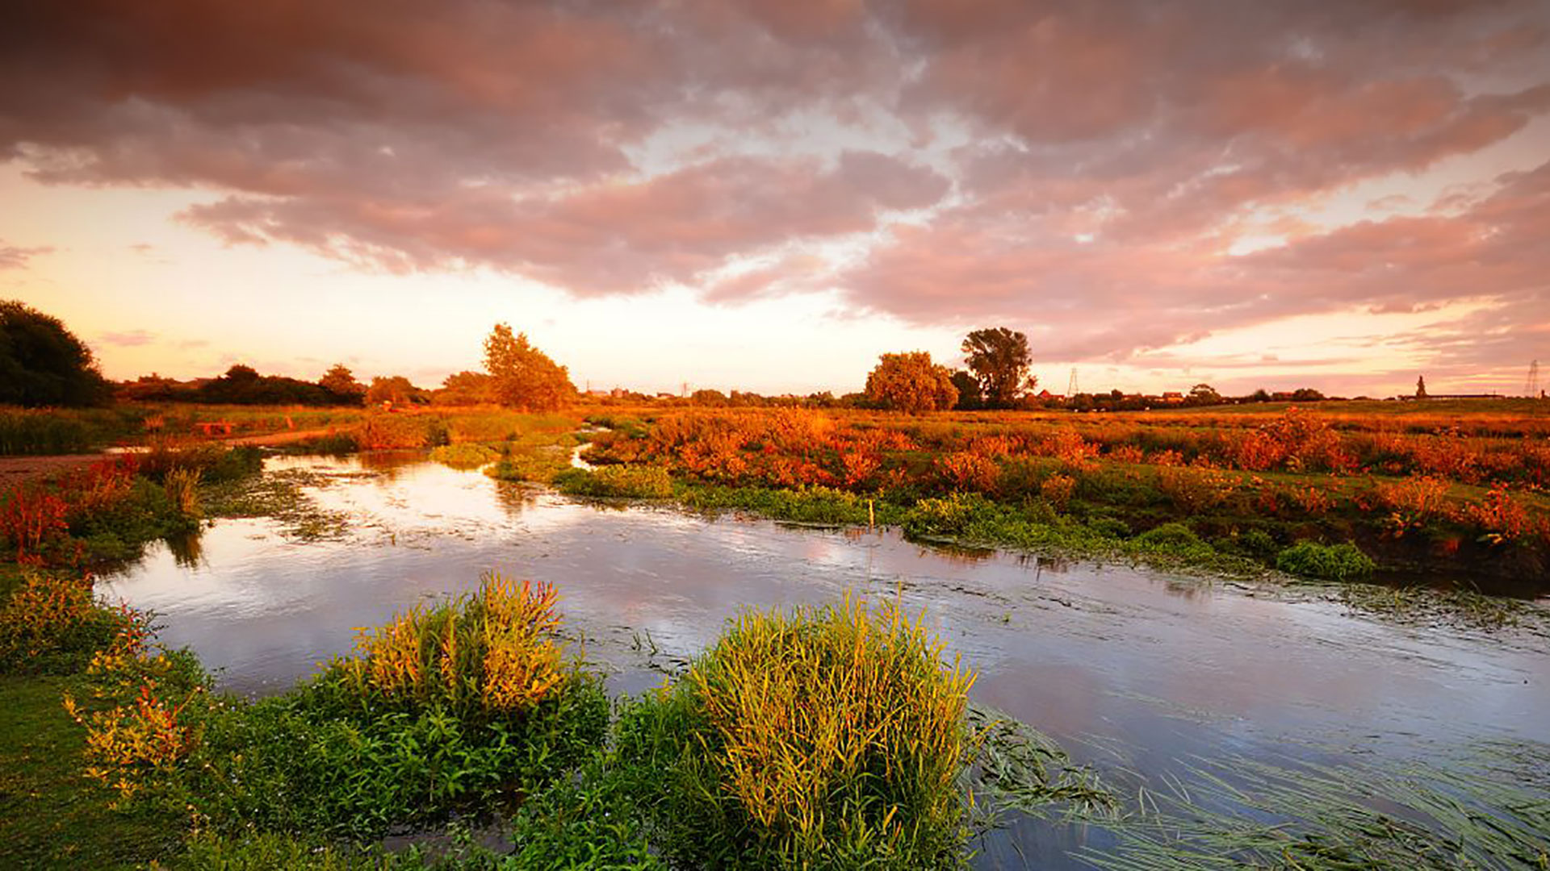
Outreach & Groundwater Sustainability Workgroup Update

Slide 4
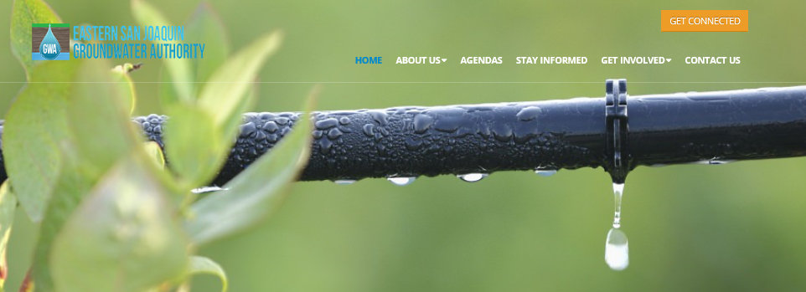
Get Connected
4

Slide 5
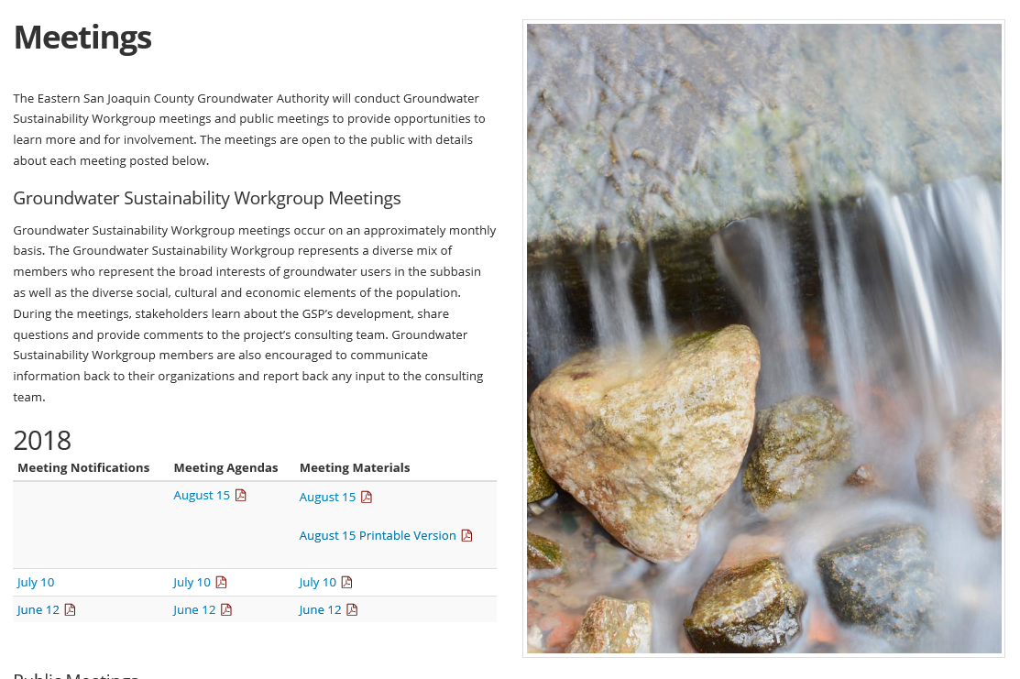
Workgroup Materials are Posted Regularly
5

Slide 6
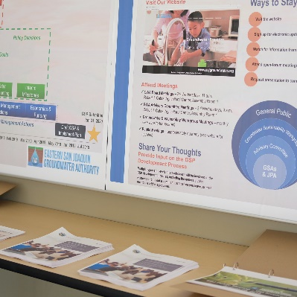
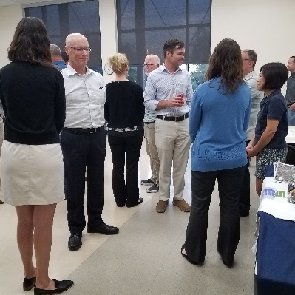
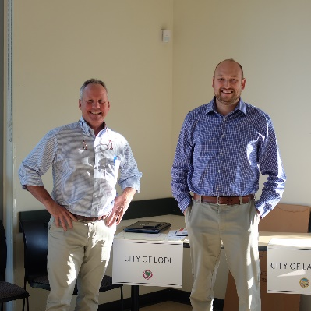
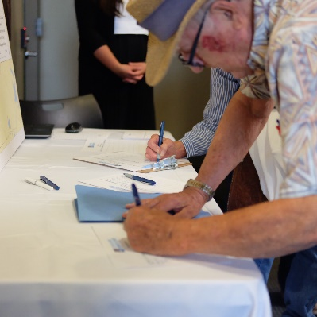
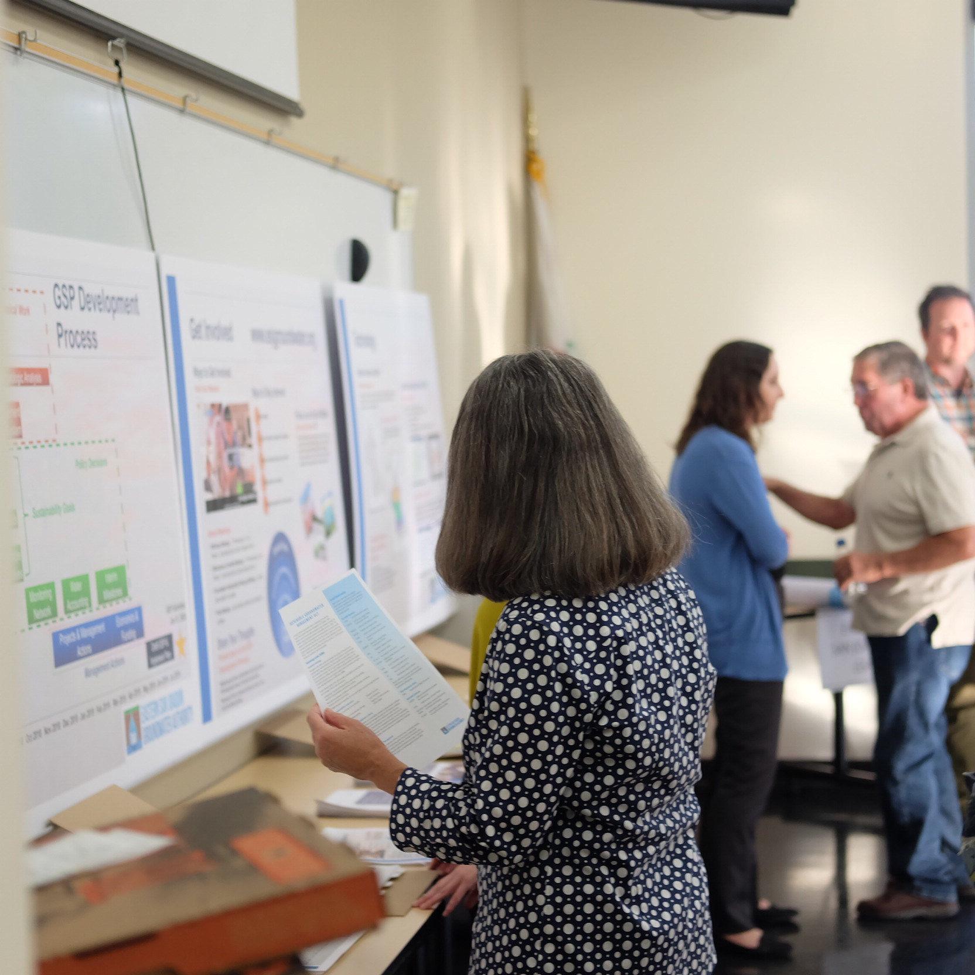
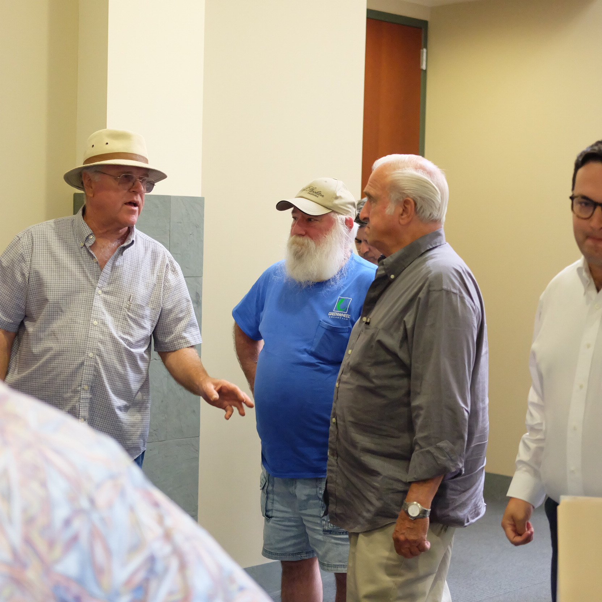
First Open House
  The first Public Open House was held on August 29
  The event followed an open house format with one outreach station for each GSA
  SGMA background was provided through four stations (Background, Process, Get Involved, Technology)
  Future public meetings are anticipated at an approximately quarterly basis
6

Slide 7
Open House Outreach Efforts
      Mailer: We distributed mailers to 400+ NGOs, local businesses & water suppliers
      Bilingual Flyer: A bilingual flyer was emailed to 200+ NGOs, local businesses, and water suppliers. It was also provided to members of the ESJ Board, Advisory Committee, & Groundwater Sustainability Workgroup
  Press Release: A press release was distributed to local media outlets & organizations with newsletters
7

Slide 8
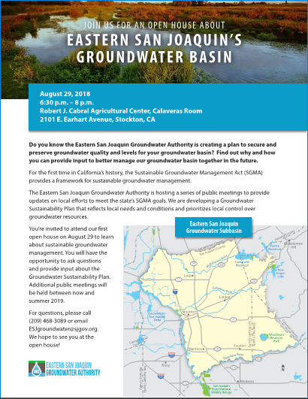


Watch for Information from Your Local GSA
      Flyers: Available in English and Spanish
  Press Releases: For organizations to include in their newsletters/blogs
  Social Media Posts: Facebook posts and Tweets by GSA member agencies
8

Slide 9

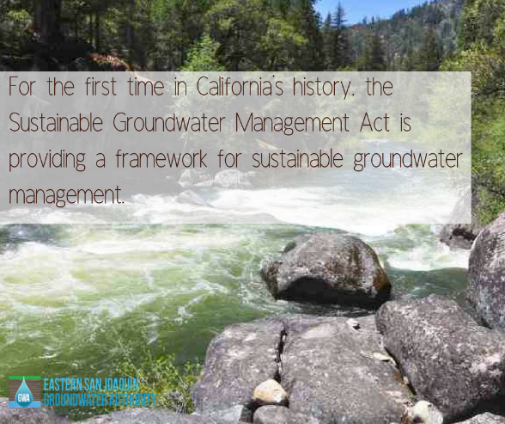
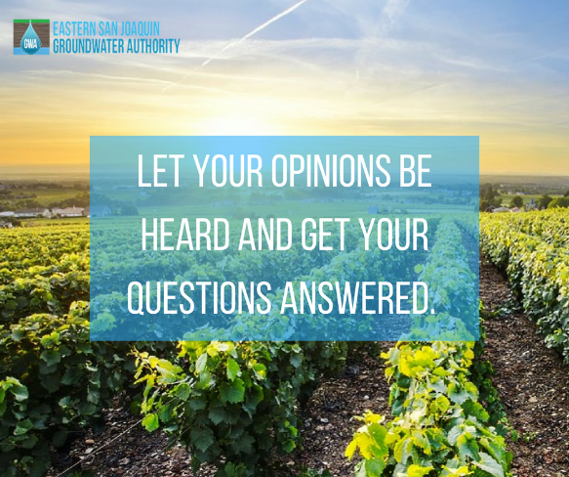
We’re On Facebook!
  @ESJGroundwaterAuthority
  Did you know the Eastern San Joaquin Groundwater Authority is creating a sustainable groundwater management plan? Our first open house was held on August 29 from 6:30–8 p.m. at the Robert J. Cabral Agricultural Center. For more information visit: www.esjgroundwater.org.
9

Slide 10
Groundwater Sustainability Workgroup Update
  9 Workgroup members and 4 members of the public attended the last meeting on August 15th
  Members are currently reviewing draft August meeting notes and providing comment
  The next Workgroup meeting will be held on September 11th from 4 – 5:30 p.m. at the Robert Cabral Ag Center, Calaveras Room
10

Slide 11
Groundwater Sustainability Workgroup: Twelve Key Values
Be implemented in an equitable manner
Be affordable and accessible
Exhibit multiple benefits to local land owners and other participating agencies
Minimize and mitigate adverse impacts to the environment including climate change
Maintain or enhance the local economy
Minimize adverse impacts to entities within the Subbasin
Maintain overlying landowner and Local Agency control of the Subbasin
Protect the rights of overlying land owners
Protect groundwater and surface water quality
Provide more reliable water supplies
Restore and maintain groundwater resources
Increase amount of water put to beneficial use within the Subbasin
11

Slide 12
GSP Update

Slide 13
Reminder – How do the Pieces Fit Together?
Document Potential Undesirable Results for Each Sustainability Indicator
Identify Appropriate Monitoring / Measurement Locations throughout Subbasin
Identify Spatially Representative Minimum Thresholds
Develop Measurable Objectives above Each Minimum Threshold
13

Slide 14




Reminder: Six Sustainability Indicators to be Addressed
Chronic lowering of groundwater levels indicating a significant and unreasonable depletion of supply
Significant and unreasonable degraded water quality
Significant and unreasonable reduction of groundwater storage
Depletions of interconnected surface water that have significant and unreasonable adverse impacts on beneficial uses of the surface water
Significant and unreasonable land subsidence
Significant and unreasonable seawater intrusion
14

Slide 15
Where are we now?
Document Potential Undesirable Results for Each Sustainability Indicator
Identify Appropriate Monitoring / Measurement Locations throughout Subbasin
Identify Spatially Representative Minimum Thresholds
Develop Measurable Objectives above Each Minimum Threshold
We are here
15

Slide 16
Major Plan Focus Areas
Working through Advisory Committee and Groundwater Sustainability Workgroup to:
  Develop concept of what sustainability means for the Subbasin and identify high priority values around groundwater
  Identify undesirable results occurring now or in the past
  Develop minimum thresholds for each sustainability indicator
16

Slide 17
Threshold Development
Mapped lowest elevation of 1992 or 2015
Met with GSAs to confirm understanding
Developed alternative methodology with high/stable groundwater elevations (variance of last 5 years of data applied to lowest level recorded as a buffer)
Identified monitoring locations for groundwater thresholds
17

Slide 18
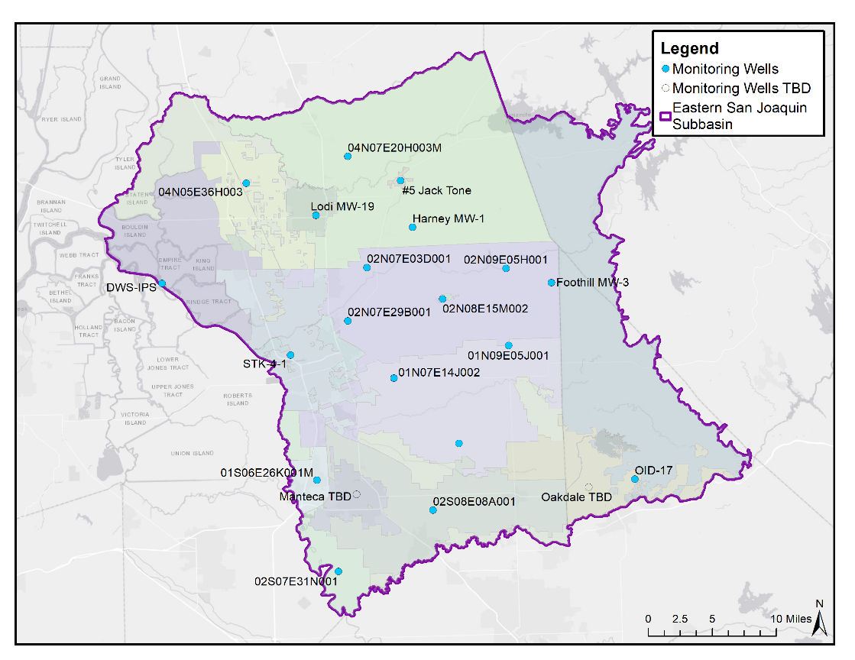
Preliminary Monitoring Well Selection
Well Characteristics
  Spatial representation (>1 well per GSA)
  Wells selected are CASGEM where available
  Wells have representative behavior of area
  Good historical record
  Well construction information
18

Slide 19
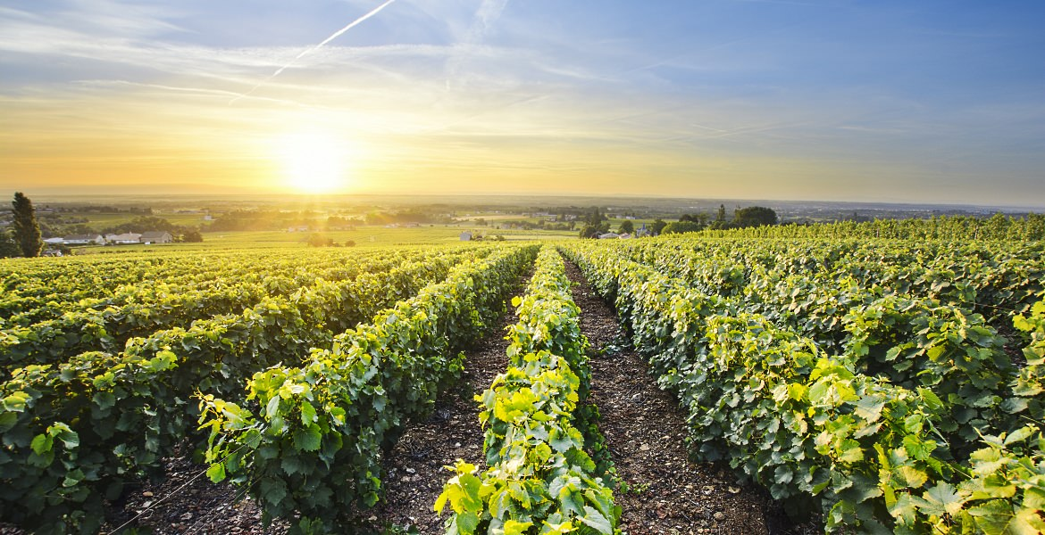
Hydrogeologic Conceptual Model Overview
4

Slide 20
HCM Development – Basic Process
The process of creating cross sections and other HCM figures comprises 3 basic steps.
Wells and Logs
Obtaining well logs from various sources.
Comparing spatial distribution of wells for usefulness in HCM.
Examining Data
Documenting well log data, such as construction and lithological information.
Organizing data for use in GIS software and DMS.
Figure Generation
Producing cross sections and 3D figures of subsurface geology and groundwater conditions via GIS software.
20

Slide 21
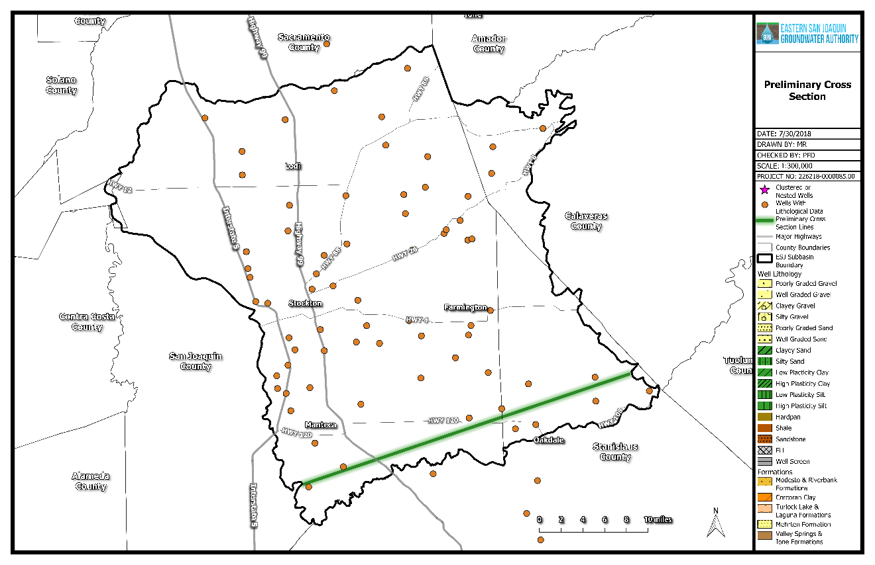
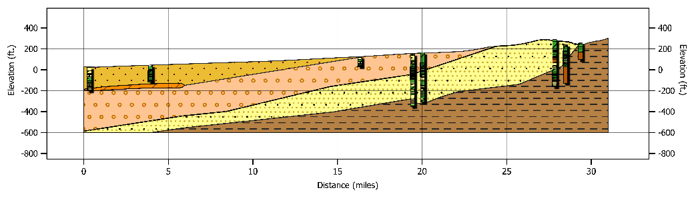
Example HCM Cross-Section
Cross sections show principal aquifers, aquitards, and stratigraphy
C’
C
21

Slide 22
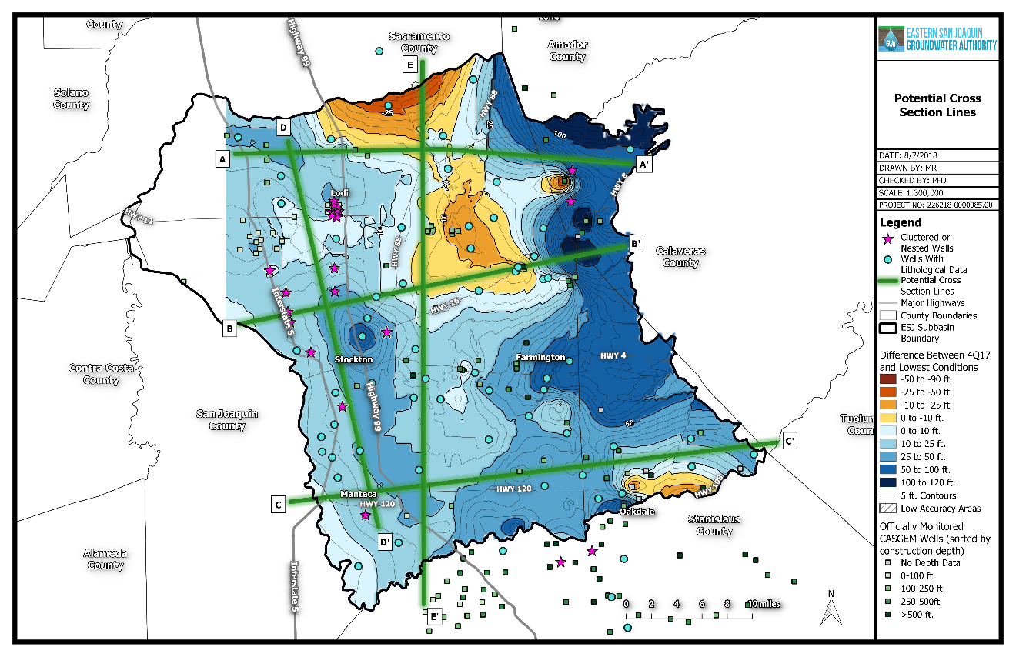
5 Preliminary HCM Cross-Sections Will be Developed for the Subbasin
Cross-section lines were chosen based on the following characteristics:
Spans the entire subbasin
Proximity to an adequate number of wells with geologic and construction information
Covers areas where current groundwater levels are lower than drought levels
22

Slide 23
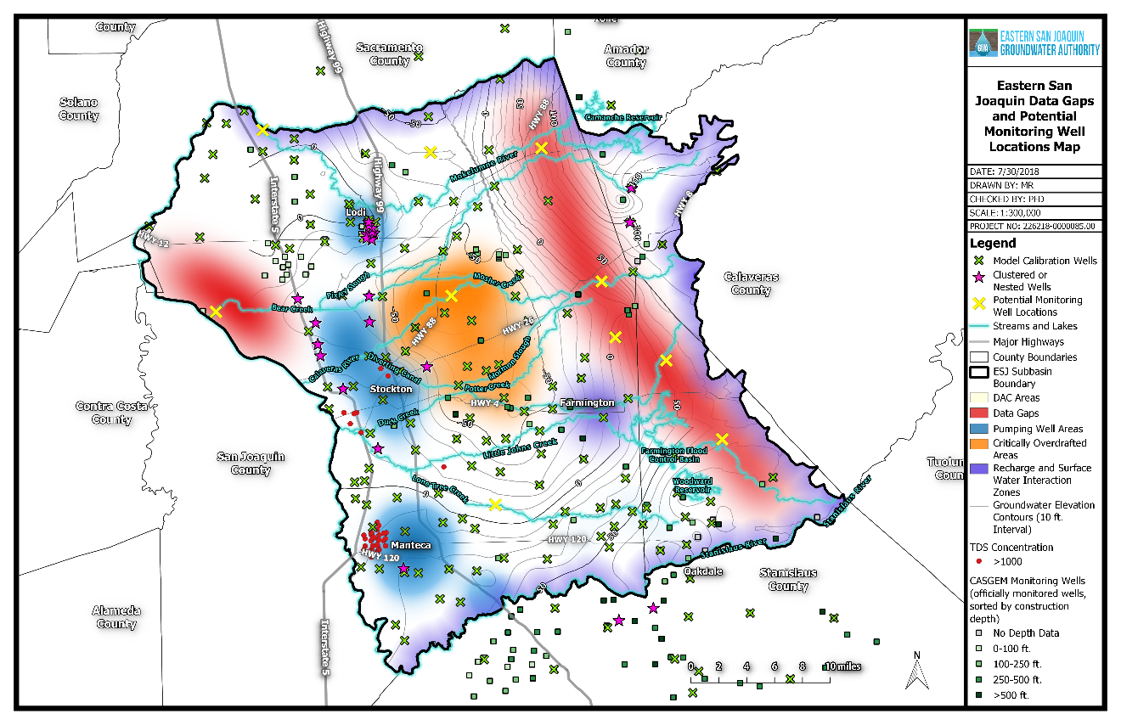
GSP Includes a Plan to Fill Data Gaps
X: potential future monitoring well location
23

Slide 24
DWR Technical Support Services Update

Slide 25

Technical Support Services Funding Update
Draft application was submitted and approved!
Working on monitoring well work order (next step)
25

Slide 26
Next Up…
Projected Water Budget
Sustainable Yield
Projects & Management Actions
26

