Slide 1
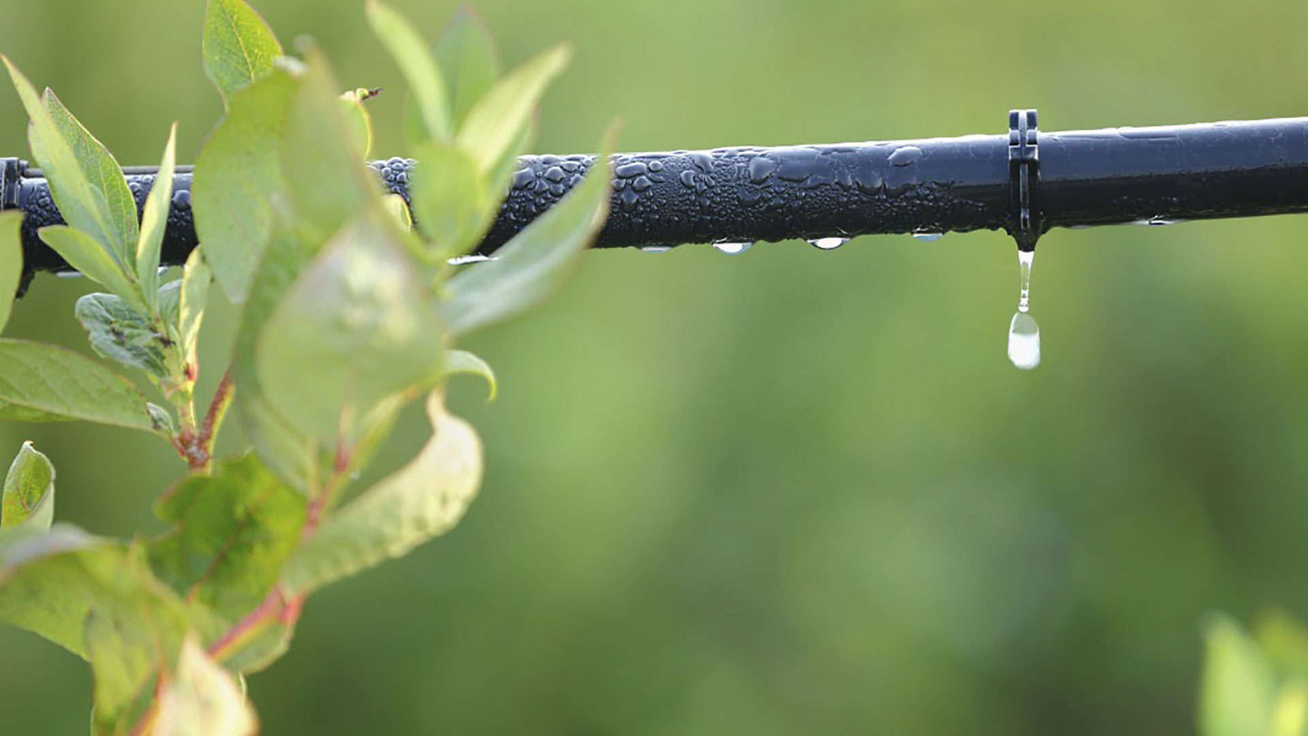
Materials for GSA Outreach October 2018

Slide 2
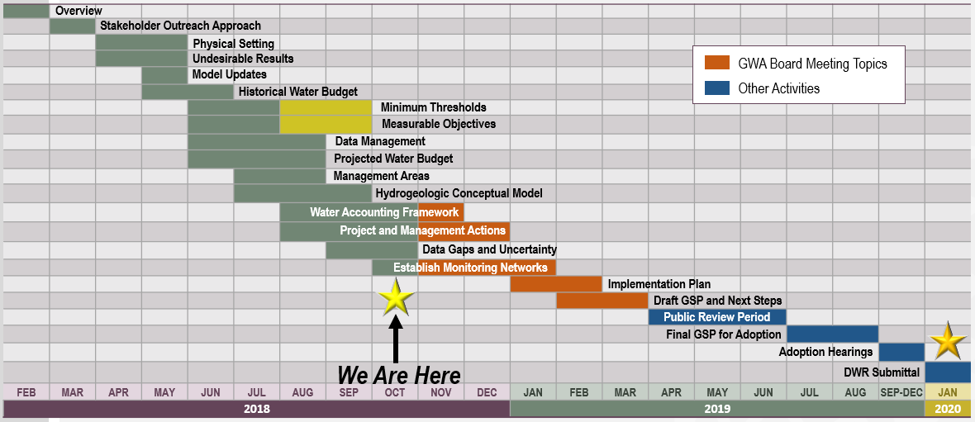
GSP Topics & Project Schedule
GSP Topics
GSP Finalization Elements
2

Slide 3
Outreach Update

Slide 4
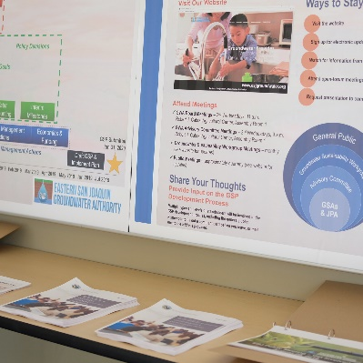
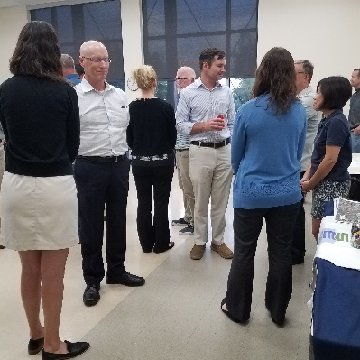
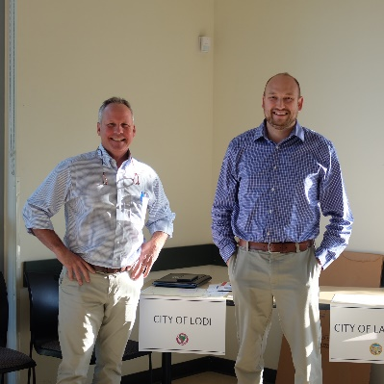
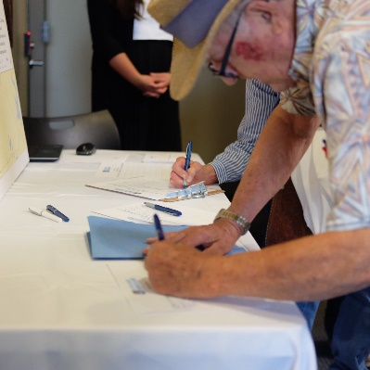
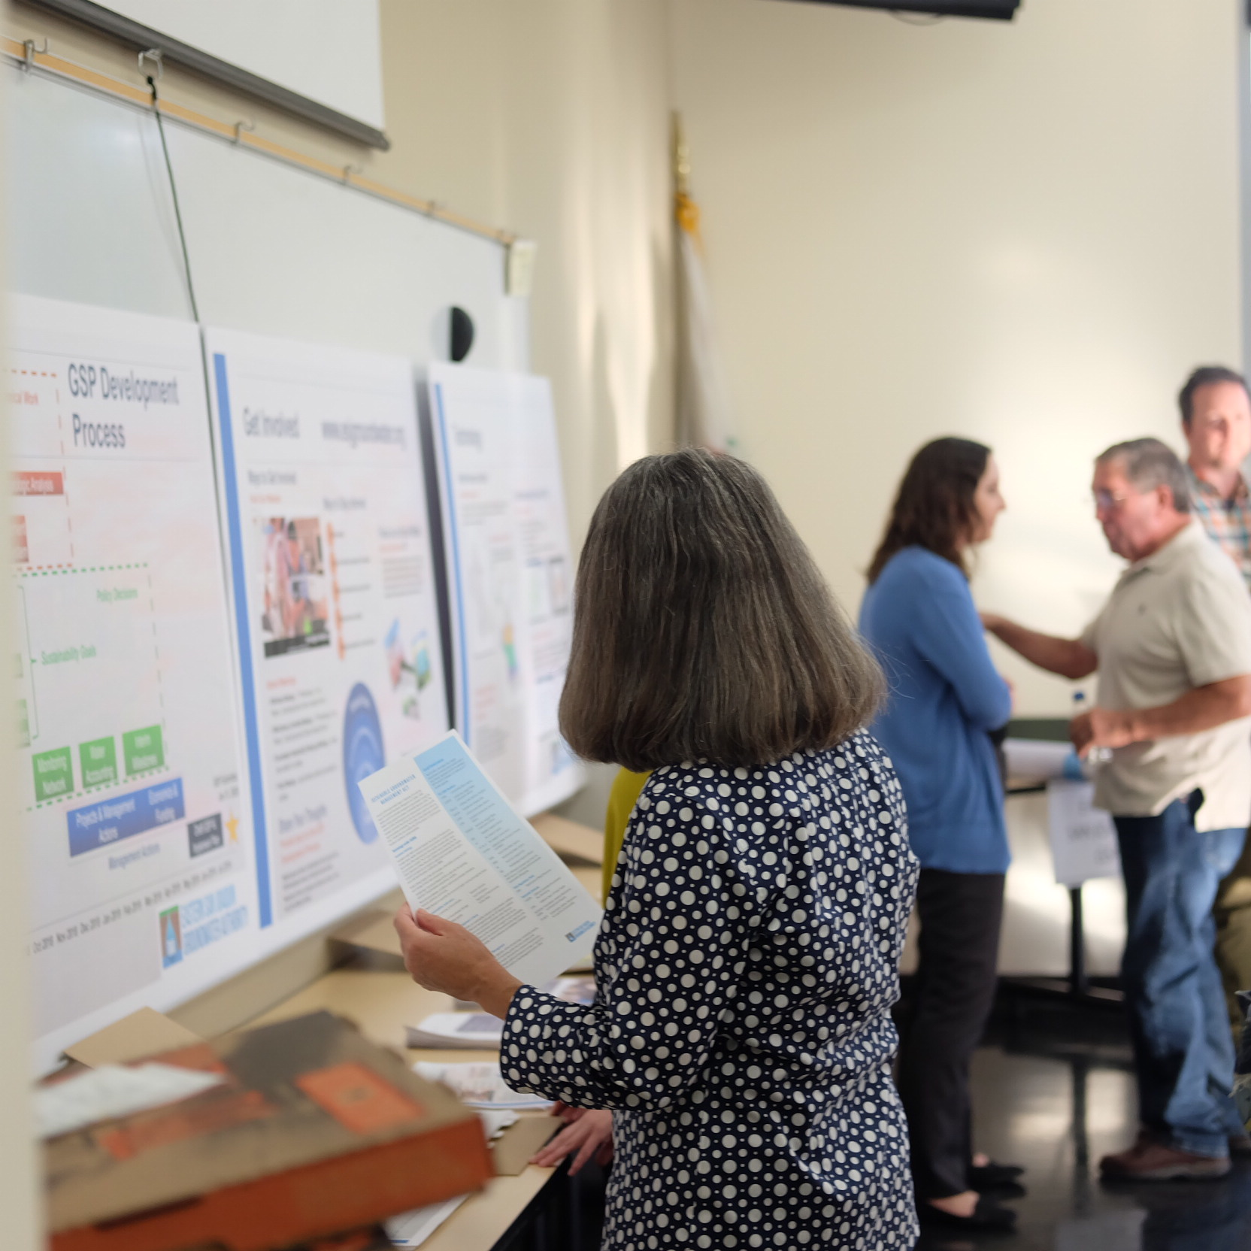
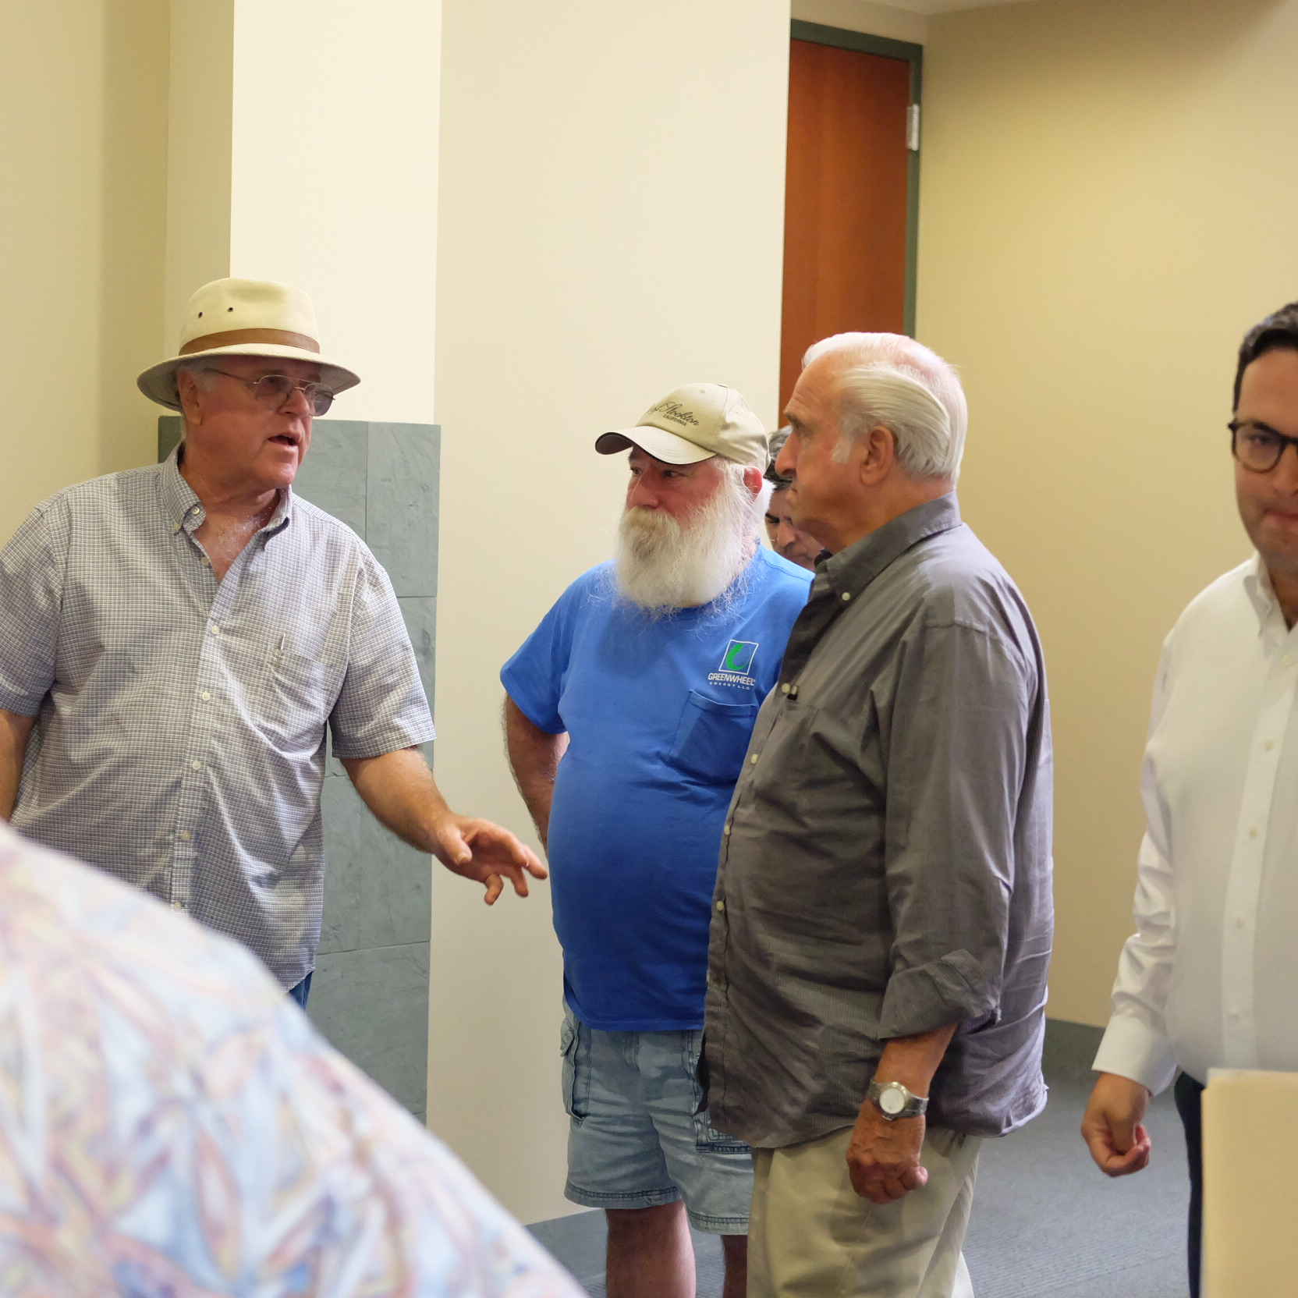
Recent Open House
The August 29th Open House was the first of four informational meetings for the GSP
~50 members of the public attended
Open house materials are posted to the website
4

Slide 5
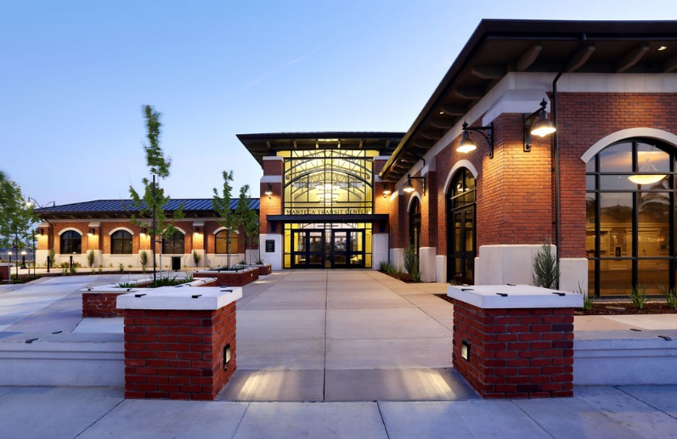
Second Informational Meeting
November 7th , 6:30-8:00 PM
Manteca Transit Center 220 Moffat Blvd. Manteca, CA 95336
5

Slide 6
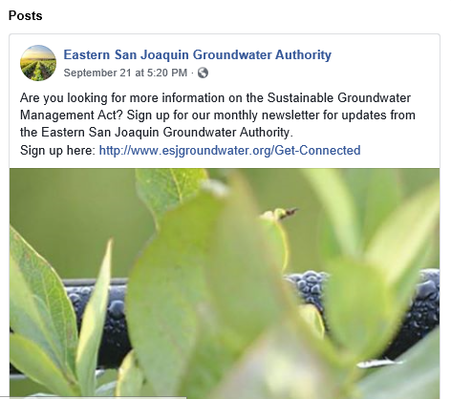
Outreach Update
The ESJ GWA Facebook page provides the most current information on upcoming events
Like the page for future updates www.facebook.com/ESJGroundwaterAuthority
6

Slide 7
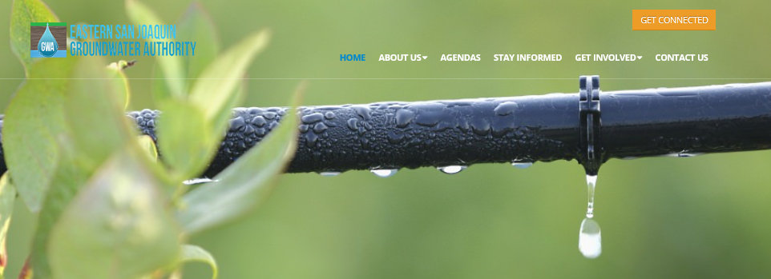
Get Connected and Subscribe for Updates
7

Slide 8
Groundwater Sustainability Workgroup Update
The September Workgroup meeting was held on September 11th from 4 – 5:30 p.m. at the Robert Cabral Ag Center, Mokelumne Room
Situation Assessment interviews are underway
The next Workgroup meeting will be held on October 9th from 4 – 5:30 p.m. at the Robert Cabral Ag Center, Delta Room
8

Slide 9
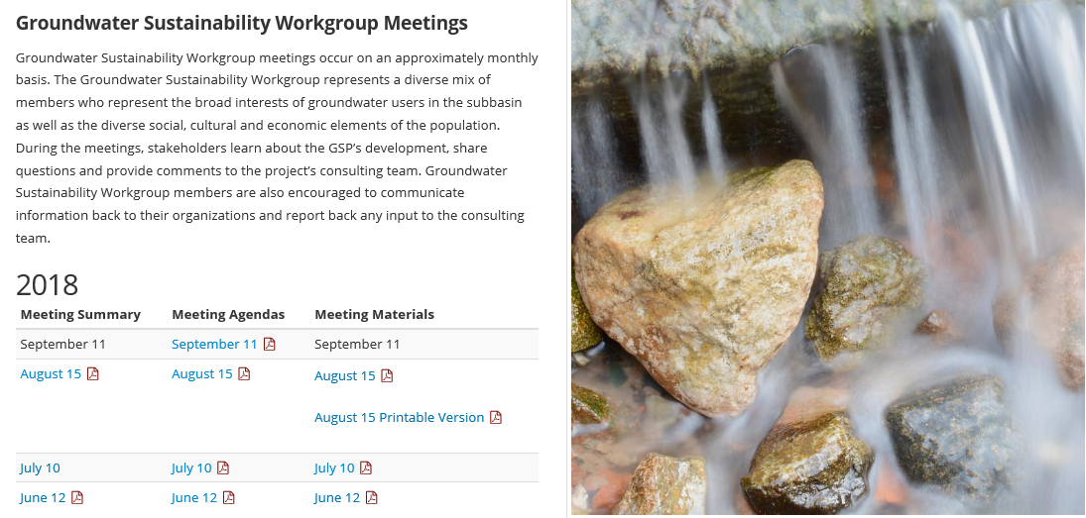
Reminder – Workgroup Materials are Posted
http://www.esjgroundwater.org/Get-Involved/Meetings
9

Slide 10
Sustainable Yield
4

Slide 11
What is Sustainable Yield?
“Sustainable yield means the maximum quantity of water, calculated over a base period representative of long-term conditions in the basin and including any temporary surplus, that can be withdrawn annually from a groundwater supply without causing an undesirable result.”
California Water Code Section 10721
11

Slide 12
Sustainable Yield Actions
Demand-side sustainability actions:
Reduce agricultural and urban GW use to achieve sustainability
Supply-side sustainability actions:
Identify project and management actions to achieve sustainability
Composite sustainability actions:
Combination of demand-side and supply-side actions
12

Slide 13
Sustainable Yield Modeling Assumptions
Determine GW use reduction by 2040 to provide a soft transition to complete sustainability conditions
Basin Storage
20-Years
50-Years
Implementation Period
Sustainable Management
13

Slide 14
Summary: Sustainable Yield
To maintain sustainability, long-term GW use to be reduced between 2020 and 2040
Next Steps:
Supply-side sustainability actions: Identify project and management actions to achieve sustainability
14

Slide 15
Projects and Management Actions
4

Slide 16
Approaches to Meeting Sustainable Yield
Allocation Approach
Basin-Wide Approach
AF/acre groundwater allocation to meet sustainable yield
Basin-wide supply projects eliminate overdraft
Groundwater allocations are assigned to GSAs based on acreage; GSAs implement additional supply projects as needed / desired
All groundwater users pay into project implementation
Basin Sustainability
16

Slide 17
Comparison of Approaches
 | Pros | Cons
Allocation Approach | Standardized approach Clear cut limits on pumping | Metering needed Pumping limitations may be significant in some areas More GSA oversight required
Basin-Wide Approach | May be more cost-effective Could be scalable Well positioned for outside funding Preserves flexibility | Projects must be economically feasible
17

Slide 18
October Workshop
A Projects and Management Actions workshop will be held as an extension to the Board Meeting
October 10, 2018 11:00-2:30 pm Robert J. Cabral Agricultural Center 2101 E. Earhart Ave. Stockton, CA
18

Slide 19
DWR Technical Support Services Update

Slide 20
Technical Support Services Funding Update
DWR coordinating revision of language in agreement for finalization
Monitoring well screening/prioritization for TSS
20

