Slide 1
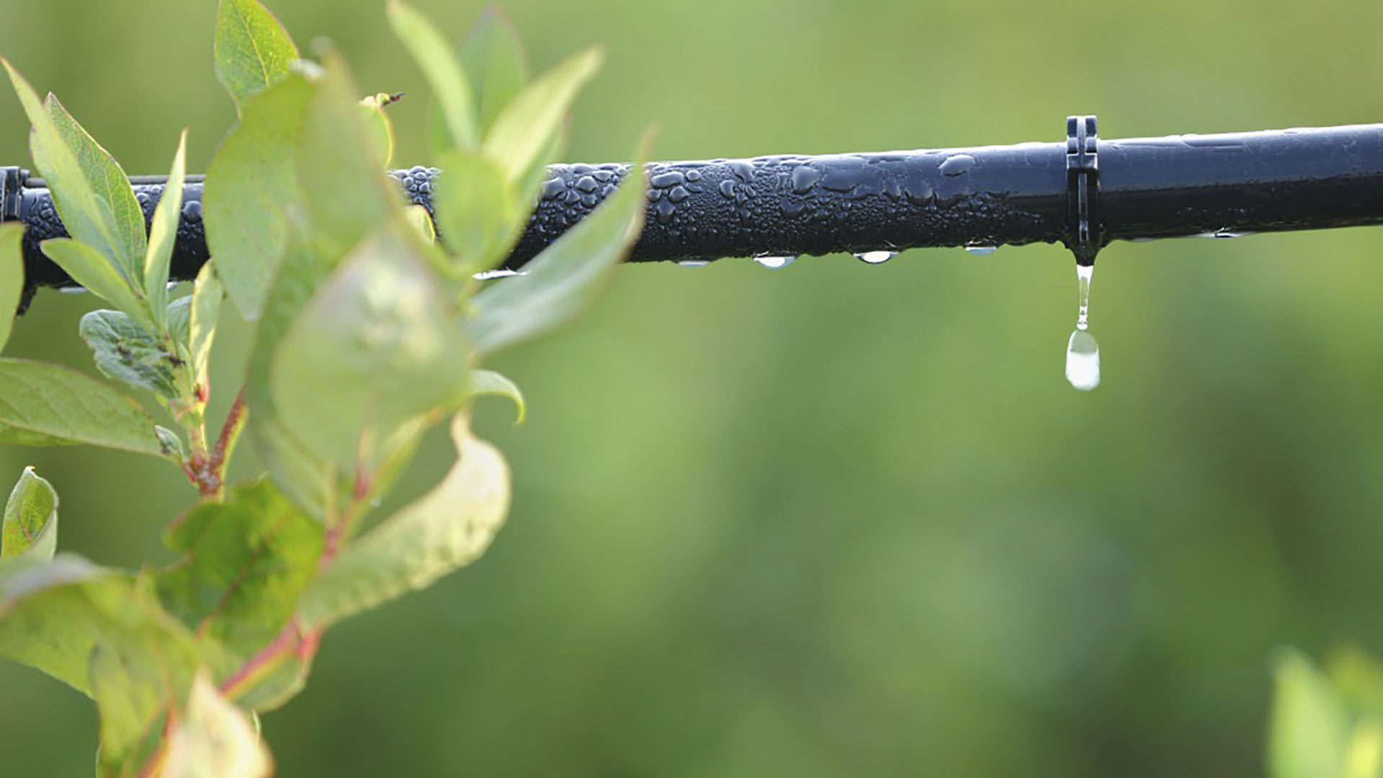
Materials for GSA Outreach May 2018

Slide 2
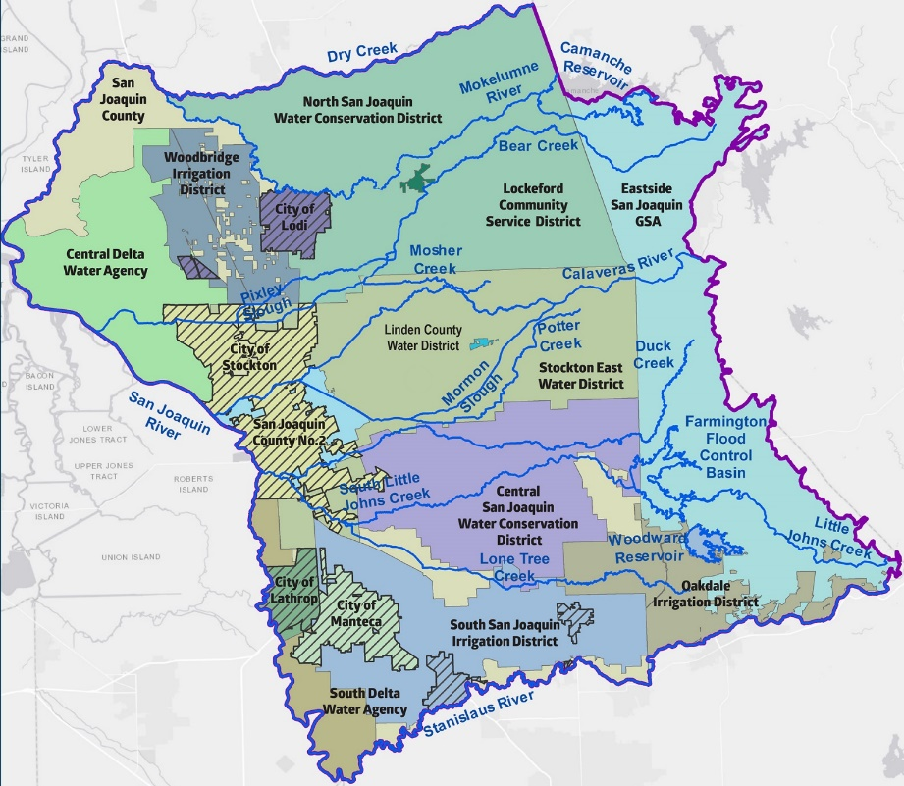
What is the ESJ GWA?
Joint Powers Authority, established to complete a single Groundwater Sustainability Plan.
Includes 17 GSAs in the Eastern San Joaquin Subbasin.
1

Slide 3
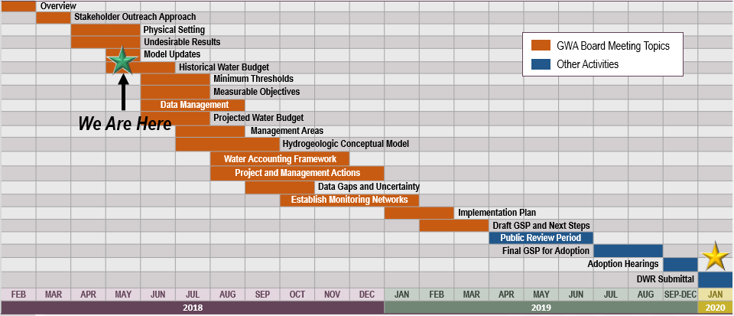
GSP Topics & Project Schedule
GSP Topics
GSP Finalization Elements
3

Slide 4
Coordination & Collaboration
4

Slide 5
How to Get Involved?
Apply to participate on stakeholder committee by May 11, 2018 – application available on esjgroundwater.org
Attend first stakeholder committee meeting as an observer (anticipated May/June 2018)
Plan to participate in first public meeting (anticipated June/July 2018)
Attend ESJ GWA Board meetings

Slide 6
Ways to Stay Informed
Website:
Visit esjground water.org
Sign up for electronic updates at ESJgroundwater@ sjgov.org
Watch for information from GSA, Plan Advisory Committee and Stakeholder Committee members (members to receive content toolkits for use, if desired, in May)
Attend open-forum meetings

Slide 7
Content Toolkit (May)
Announcement article for use on websites and in communications materials (newsletters, electronic communications, etc.)
Social media calendar (Facebook and Twitter content to share announcement, direct people to ESJ GWA website and notifications about meetings)
Public meeting newsletter file for distribution (anticipated end of May/early June)

Slide 8
Formation: Timeline and Approach
April
Application emailed to over 100 NGOs
Application shared with 143 public agencies for notification and sharing with other stakeholders
Application mailed to 433 community water systems
May
Interested parties complete and submit applications by May 11
Collaborate with staff to review applicants and form recommendation
Provide update to JPA
May - June
Notify applicants of the selected stakeholder committee
Develop and finalize charter for stakeholder committee
Committee members sign charter
Hold first meeting (target late May/June)

Slide 9
Technical Development of GSP
10

Slide 10
Next Steps for within GSP Development Process
Document Potential Undesirable Effects for Each Sustainability Indicator
Identify Minimum Thresholds for Each Location
Develop Measurable Objectives above Each Minimum Threshold
Identify Appropriate Monitoring / Measurement Locations throughout Subbasin
10

Slide 11
Six “Sustainability Indicators” - Categories of Negative Groundwater-Related Impacts
Will be described and managed through the GSP
Chronic Lowering of Groundwater Levels
Reduction in Groundwater Storage
Seawater Intrusion
Degraded Water Quality
Land Subsidence
Depletion of Interconnected Surface Water
11

Slide 12
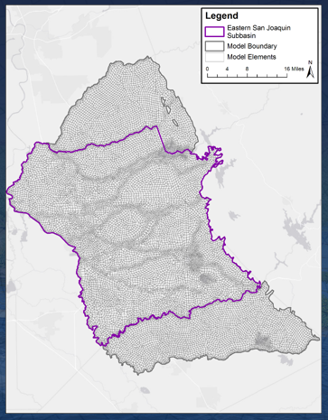
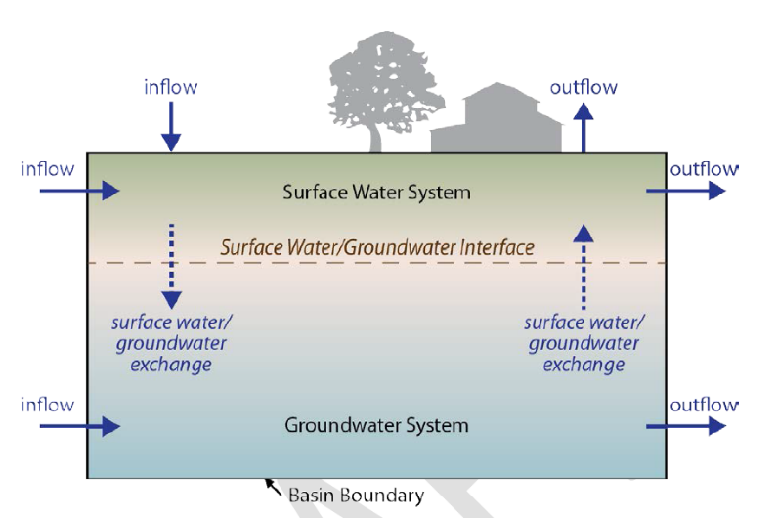
Next Up…
Groundwater Model, Historical Water Budget
14

Slide 13
Glossary of Terms
12

Slide 14
Understanding Key Terminology is Important
Significant and Unreasonable
Sustainable Groundwater Management Act
Hydrogeologic Conceptual Model
Measurable Objective
Minimum Threshold
Interim Milestone
Undesirable Results
Groundwater Conditions
Basin Settings
Sustainability Indicator
Water Budget
Margin of Operational Flexibility
14

Slide 15
Let’s Talk Terminology
Why are terms important?
Established by regulation
Used by regulators during GSP review
Consistency of terms assists SGMA discussion
Important to understand is the relationship between:
Sustainability Indicators
Undesirable Results
Minimum Thresholds
Measurable Objectives a. Interim Milestones b. Margin of Operational Flexibility
Monitoring Network
15

Slide 16
Undesirable Results are Significant and Unreasonable Impacts
“Chronic lowering of groundwater levels indicating a significant and unreasonable depletion of supply if continued over the planning and implementation horizon”
“Significant and unreasonable reduction in groundwater storage”
“Significant and unreasonable seawater intrusion”
Chronic Lowering of Groundwater Levels
Reduction in Groundwater Storage
Seawater Intrusion
16

Slide 17
Undesirable Results are Significant and Unreasonable Impacts
“Significant and unreasonable degraded water quality, including the migration of contaminant plumes that impair water supplies”
“Significant and unreasonable land subsidence that substantially interferes with surface land uses”
“Depletions of interconnected surface water that have significant and unreasonable adverse impacts on beneficial uses of the surface water”
Degraded Water Quality
Land Subsidence
Depletion of Interconnected Surface Water
17

Slide 18
Minimum Thresholds
Point at which undesirable results may begin to occur
The lowest the basin can go at this monitoring point without something significant and unreasonable happening to groundwater
Quantitative thresholds
18

Slide 19
Measurable Objectives are 2040 targets that provide a buffer to prevent Undesirable Results
Establish the high side of an operating margin that the basin will be managed to in order to prevent undesirable results (above the minimum thresholds)
Quantitative targets
19

Slide 20
Interim Milestones are established to chart progress toward meeting objectives
Interim Milestone
Interim Milestones are the 5 year targets for the Measurable Objective
Margin of Operational Flexibility
Margin of Operational Flexibility is the space between the measurable objective and the minimum threshold
20

Slide 21
Monitoring Network
Is used to monitor for conditions that would cause undesirable results
Must address the six sustainability indicators
Adequate spatial and temporal coverage for each primary aquifer
Need minimum thresholds and measurable objectives for each monitoring point used in the network
21

