Slide 1
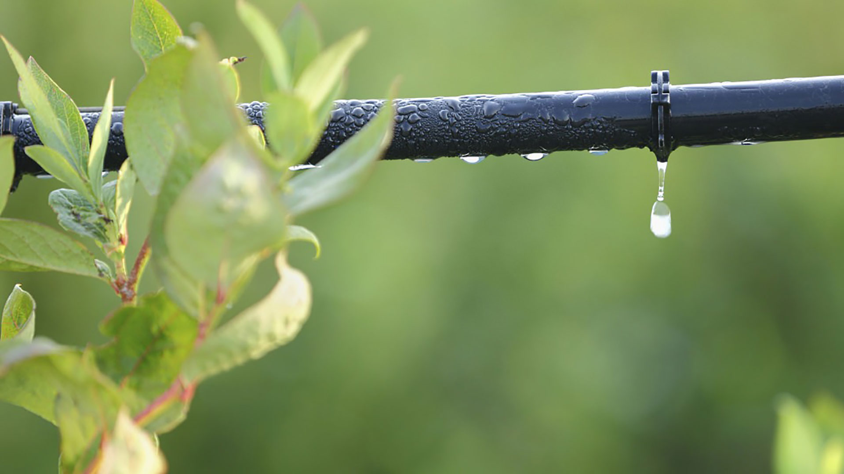

Materials for GSA Outreach
July 2018

Slide 2
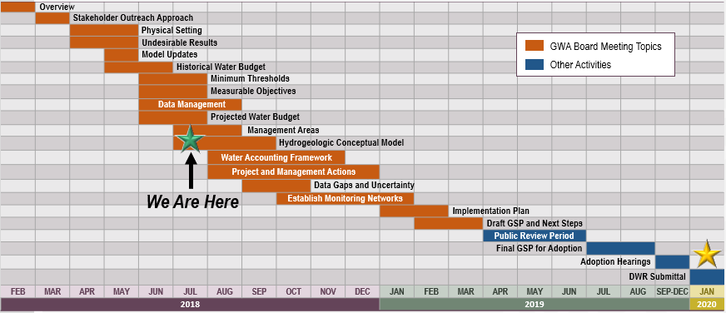
GSP Topics & Project Schedule
GSP Topics
GSP Finalization Elements
2

Slide 3
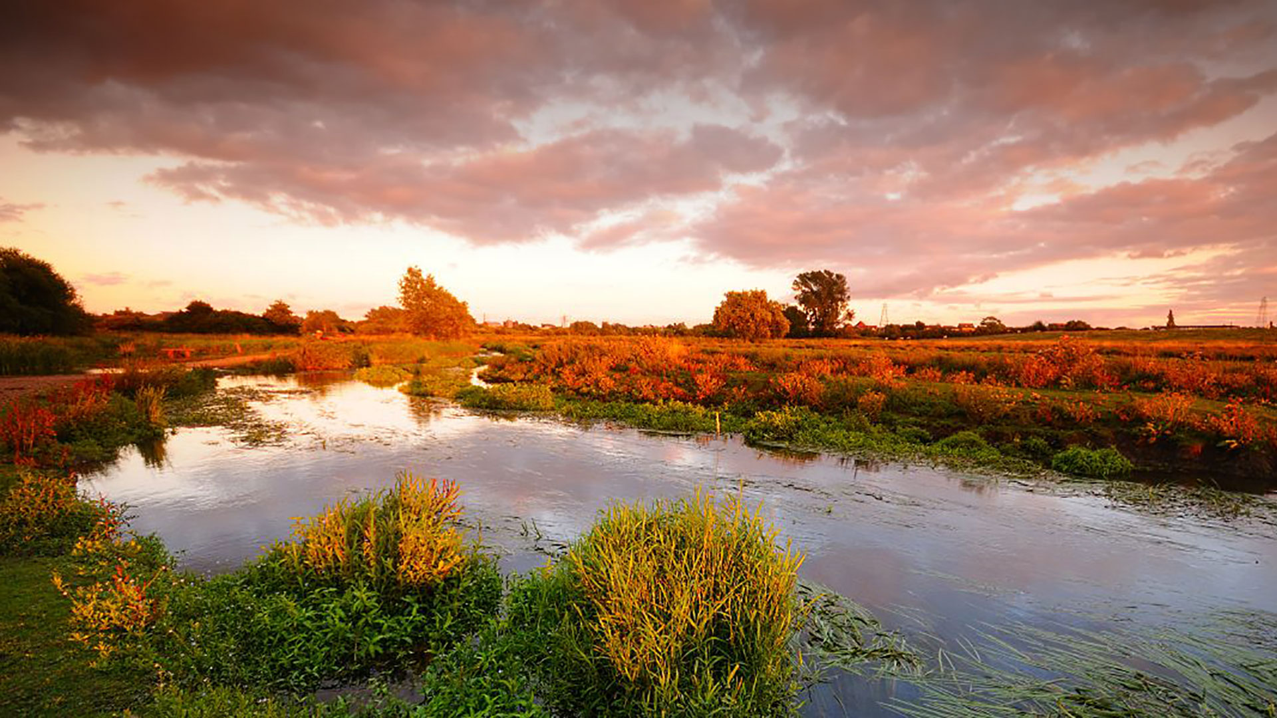
Outreach & Stakeholder Committee Update

Slide 4
Ways to Get Involved
Attend Stakeholder Committee meetings
(monthly)
Plan to participate in first Public Meeting (anticipated July 2018)
Attend GWA Board and Advisory Committee meetings (monthly)
4

Slide 5
Ways to Stay Informed
Website:
Visit esjground
water.org
Sign up for electronic updates at esjgroundwater.org
Watch for information from GSA, Advisory Committee and Stakeholder Committee members
Attend open-forum meetings
Request presentation to community group (e.g. Kiwanis)
  esjgroundwater.org
5

Slide 6
Ways to Stay Informed
  You can now find the Draft Stakeholder Engagement and Public Outreach Plan on the website here:
  http://www.esjgroundwater.org/Stay-Informed.
6

Slide 7
Stakeholder Committee Kickoff
The first Stakeholder Committee Meeting was held on June 12th.
The next Stakeholder Committee meeting will be on July 10 at 4:00 at Calaveras Room, Robert Cabral Agricultural Center, 2101 E. Earhart Avenue, Suite 100, Stockton, CA 95206
Meetings are open to the public
7

Slide 8
Final Stakeholder Committee Roster
2Q Farming
Calaveras County Resource Conservation District
Catholic Charities of the Diocese of Stockton
The Hartmann Law Firm/Advisory Water Commission
San Joaquin Audubon
Sierra Club
San Joaquin Farm Bureau Federation
Trinchero Family Estates and Sutter Home Winery
South Delta Water Agency
San Joaquin County Environmental Health Department
Manufacturers Council of the Central Valley
The Wine Group
J.R. Simplot Co.
Lima Ranch
University of the Pacific
Sequoia ForestKeeper
Ag Business – Farmer
The Environmental Justice Coalition for Water
Spring Creek Golf & Country Club
Machado Family Farms
California Sportfishing Protection Alliance
Restore the Delta
PUENTES
Total number of participants: 23
8

Slide 9
Data Management System Overview

Slide 10
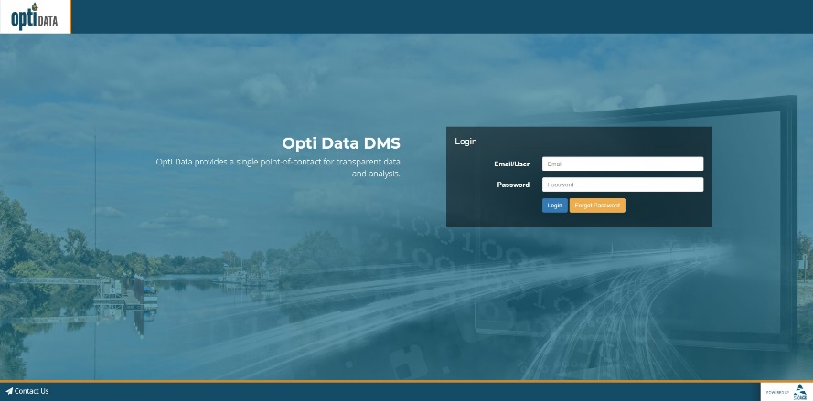
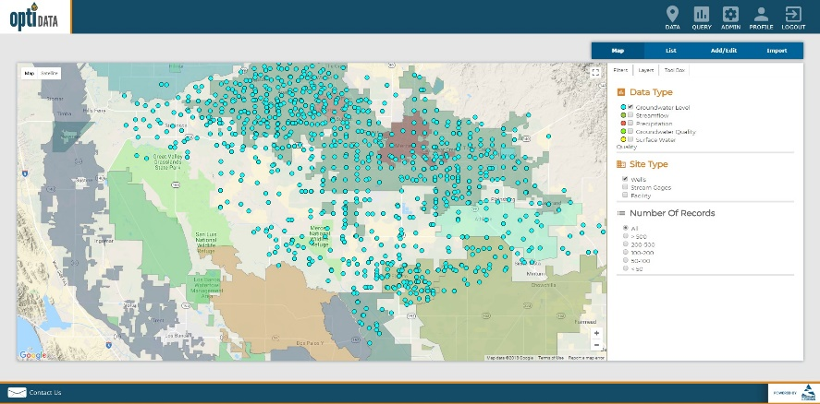
Opti is a Flexible, One-Stop Shop for Managing Groundwater Data
What is Opti?
Allows for transparent and efficient data entry and visualization
Allows for coordination and sharing of data
Allows for automated reporting
Will support sustainable groundwater management monitoring and give ESJ the ability to track undesirable results
10

Slide 11
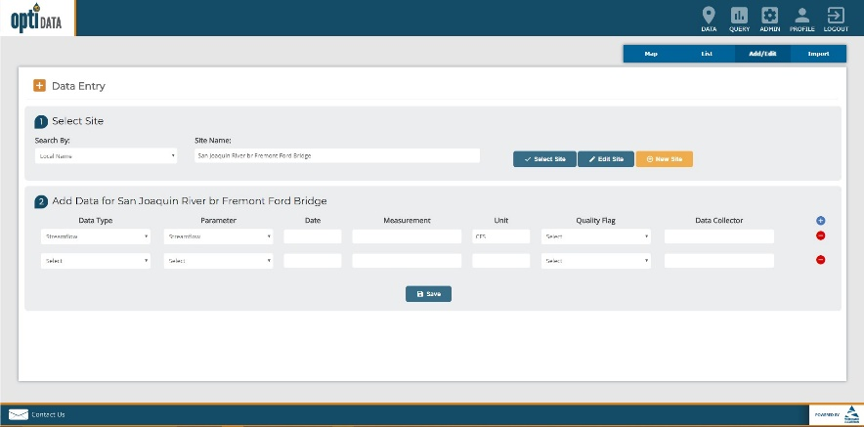
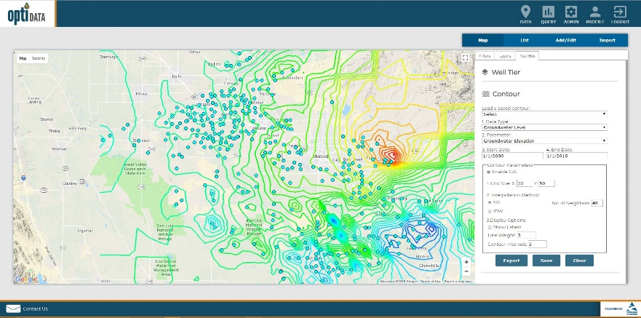
Opti Features
Web-based, GIS-enabled
Easy-to-Use
Flexible Data Structure to Store and Manage Different Datasets
User and Agency Security/Permissions
Data Entry and Validation
Visualization and Analysis
Query and Reporting
Framework to Link to other Data Management Systems and Modeling Results
Viewing capabilities for publicly available information
11

Slide 12
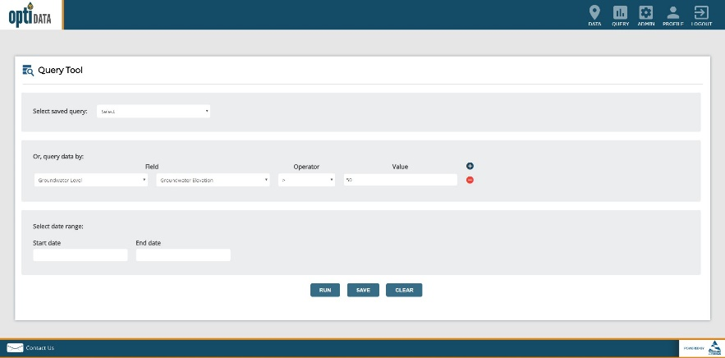
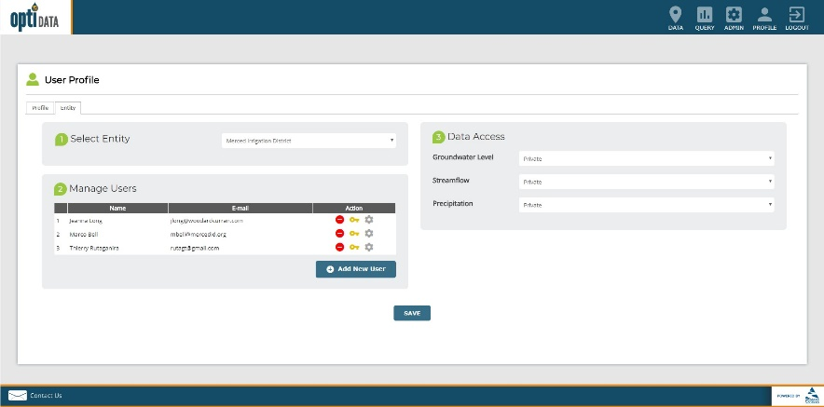
How Will Opti be Used?
Opti will create a centralized and integrated repository for multiple data sources managed by stakeholders
Data sharing portal to enable utilization of the same data and tools for visualization and analysis
Interface with model results to support groundwater modeling and analysis
Generate reports for management and other agencies (DWR, etc.)
Track sustainability criteria and management objectives
12

Slide 13

Setting Minimum Thresholds
4

Slide 14
SGMA Requires Six Sustainability Indicators to be Addressed
Chronic Lowering of Groundwater Levels
Reduction in Groundwater Storage
Seawater Intrusion
Degraded Water Quality
Land Subsidence
Depletion of Interconnected Surface Water
14

Slide 15
For Each Sustainability Indicator, We Set a Minimum Threshold and a Measurable Objective
Document Potential Undesirable Effects for Each Sustainability Indicator
Identify “Minimum Thresholds” (Levels Where Undesirable Results Could Occur)
Develop “Measurable Objectives” (Targets Above Each Minimum Threshold)
15

Slide 16
To Set Minimum Thresholds, We Built on Prior Work
Integrated Regional Water Management Plans
2004 Groundwater Management Plan
Anecdotal data from GSAs
Agricultural Water Management Plans
MokeWISE Water Program
Model Development Data Collection
16

Slide 17
Minimum Thresholds for Sustainability Indicators
Chronic Lowering of Groundwater Levels
Reduction in Groundwater Storage
Seawater Intrusion
Degraded Water Quality
Land Subsidence
Depletion of Interconnected Surface Water
17

Slide 18
Prior Work Establishes Minimum Threshold at Fall 1992 Levels
A threshold has been established at 1992 levels:
“The Eastern San Joaquin Groundwater Basin contour measured in 1992 is proposed as the basin management framework baseline. Groundwater fell to its lowest recorded elevation in 1992 following a significant drought period and it is considered undesirable to drop below this level.” (2014 ESJ IRWMP)
18

Slide 19
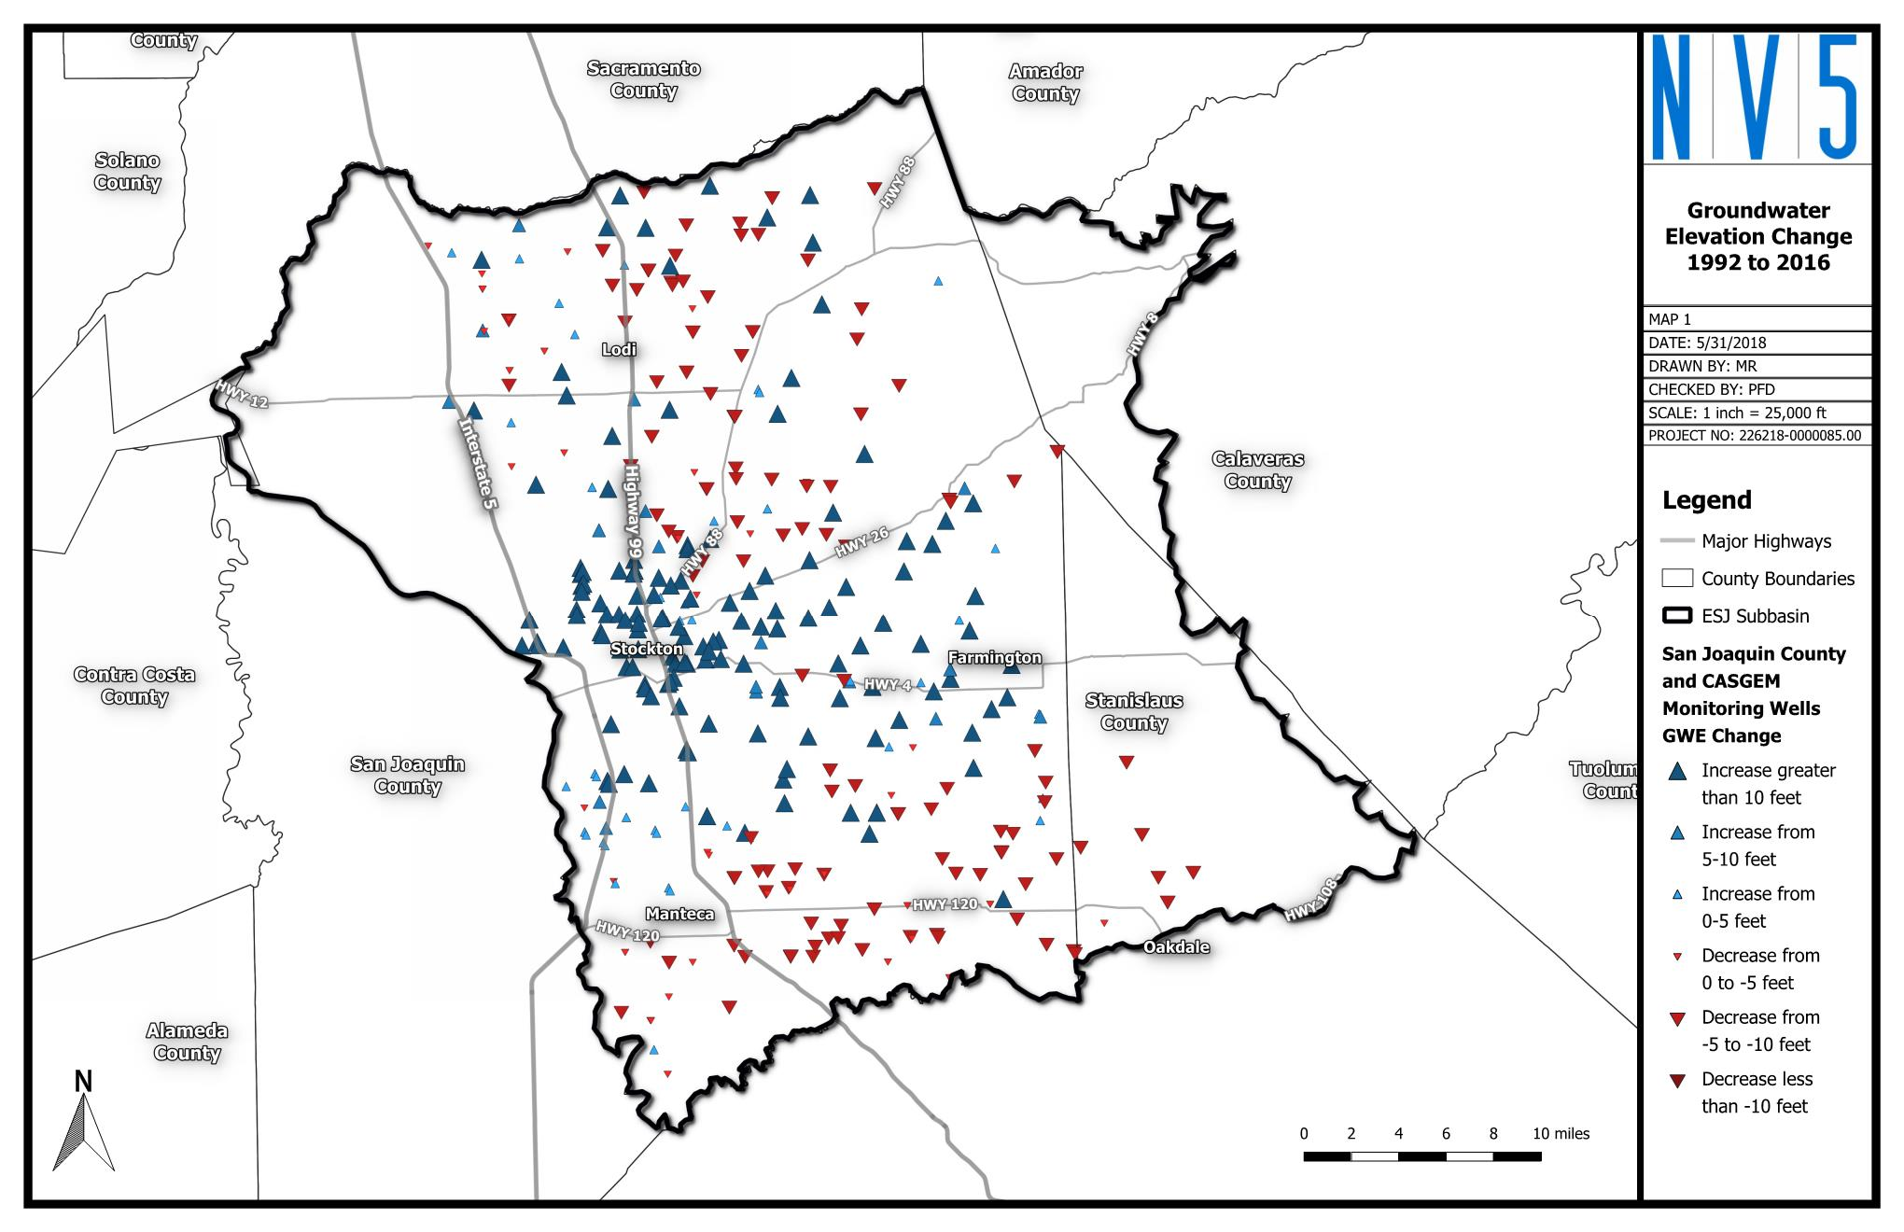
Setting a Threshold: Look to Historical Lows After Last Drought
(red) – Areas that have declined since 1992
(blue) – Areas that have recovered since 1992
19

Slide 20
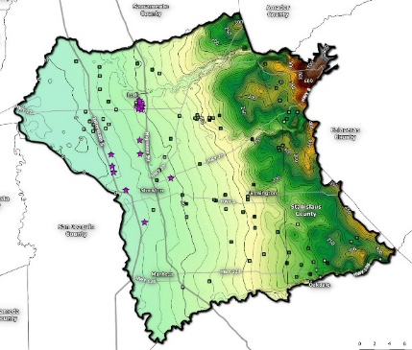
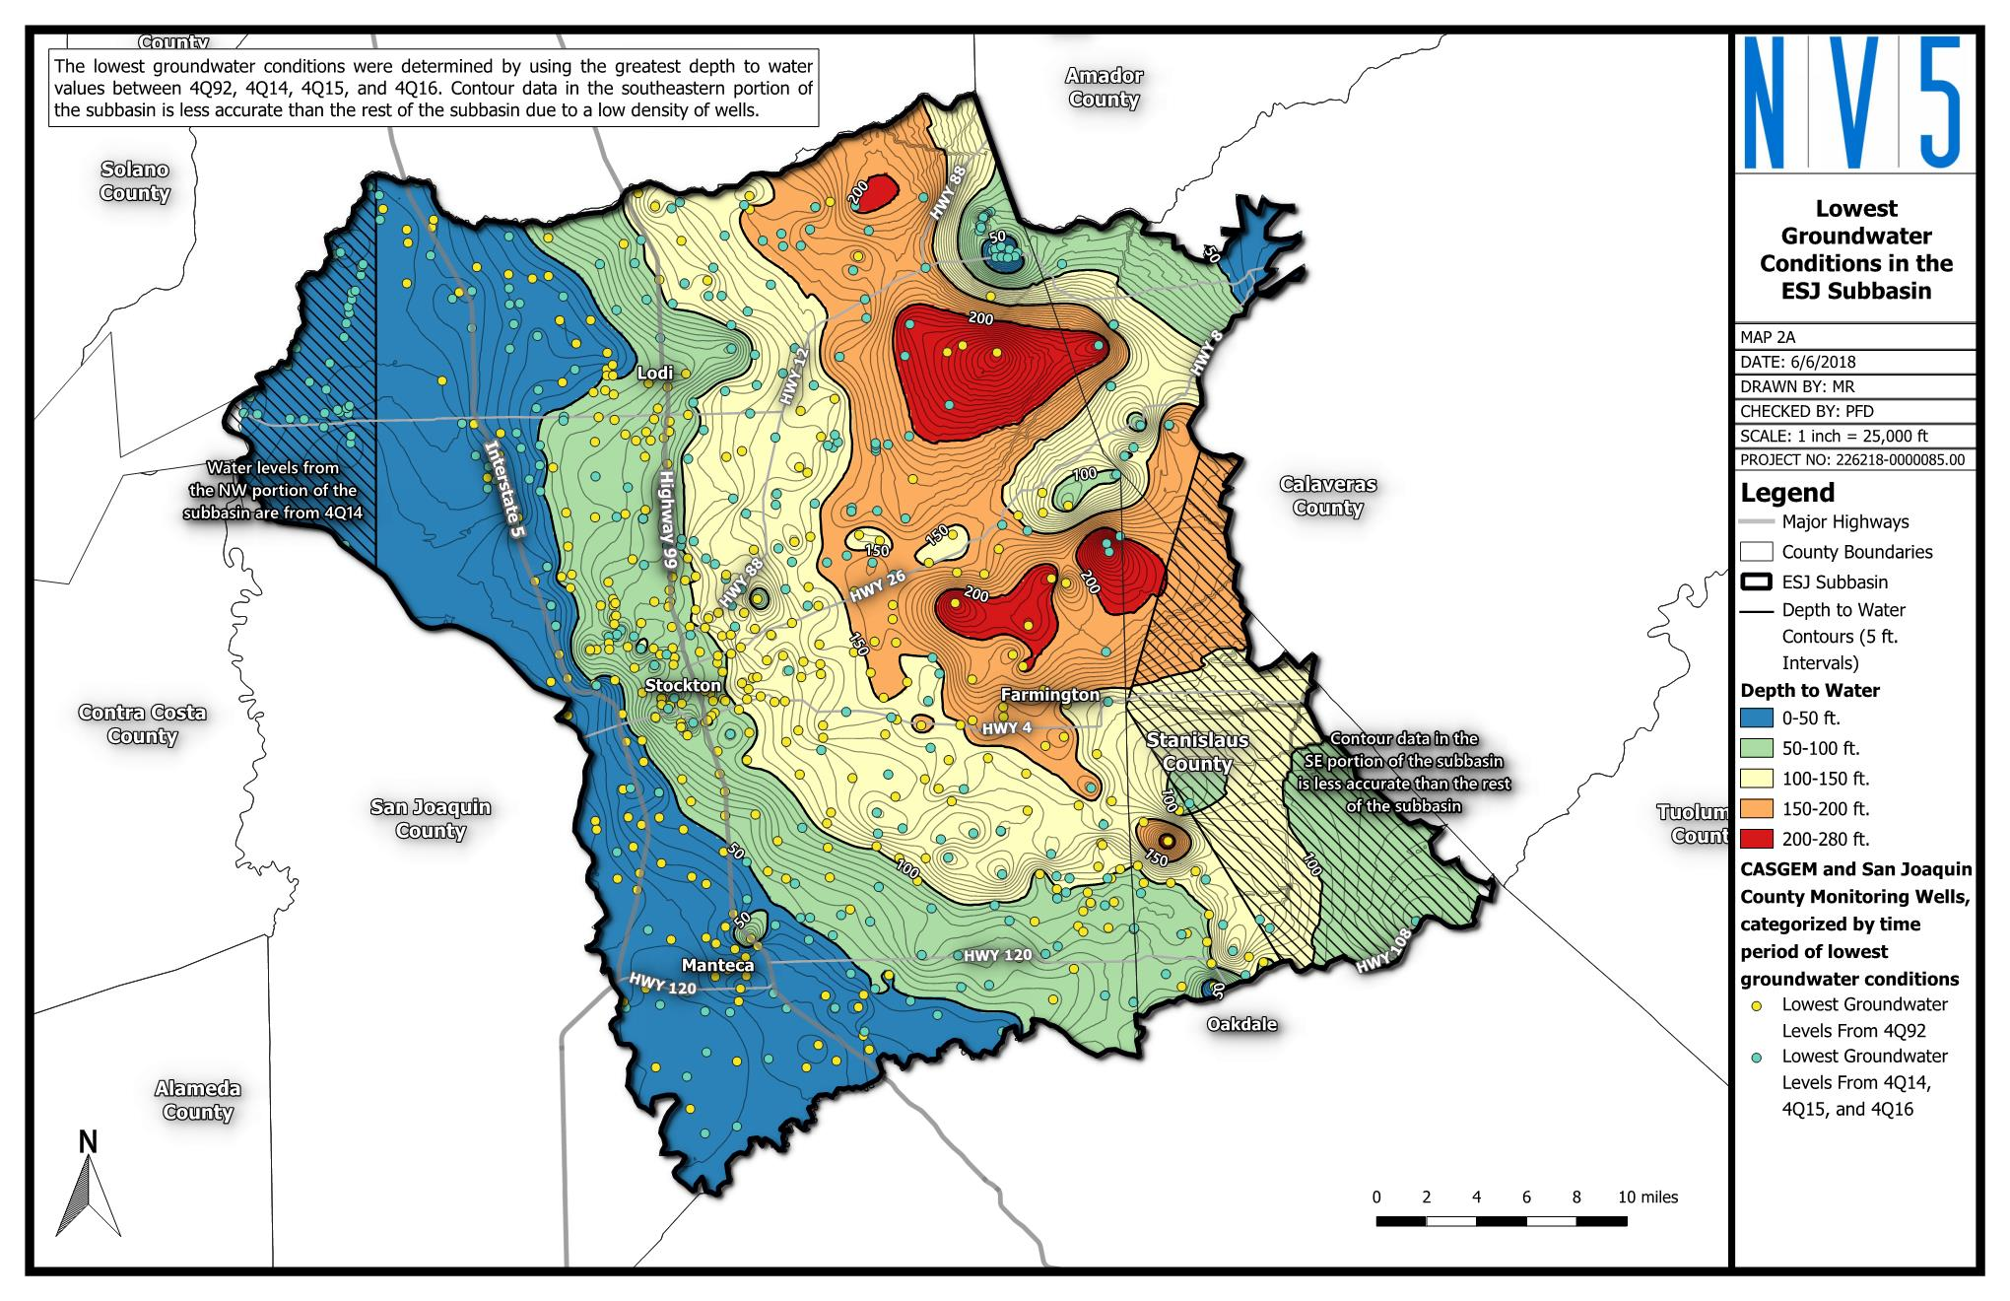
We Can Set a Threshold to Capture the Lowest Lows
(Yellow) – Areas where threshold is based on 1992 levels
(Blue) – Areas where threshold is based on 2015-16 levels
20

Slide 21
Minimum Thresholds for Sustainability Indicators
Chronic Lowering of Groundwater Levels
Reduction in Groundwater Storage
Seawater Intrusion
Degraded Water Quality
Land Subsidence
Depletion of Interconnected Surface Water
21

Slide 22
Reduction in Groundwater Storage
This Sustainability Indicator is not a concern for the Subbasin
***This does not mean we do not need to bring the basin into balance, it only means that groundwater-related impacts will be more sensitive to other indicators, such as groundwater elevations.
22

Slide 23
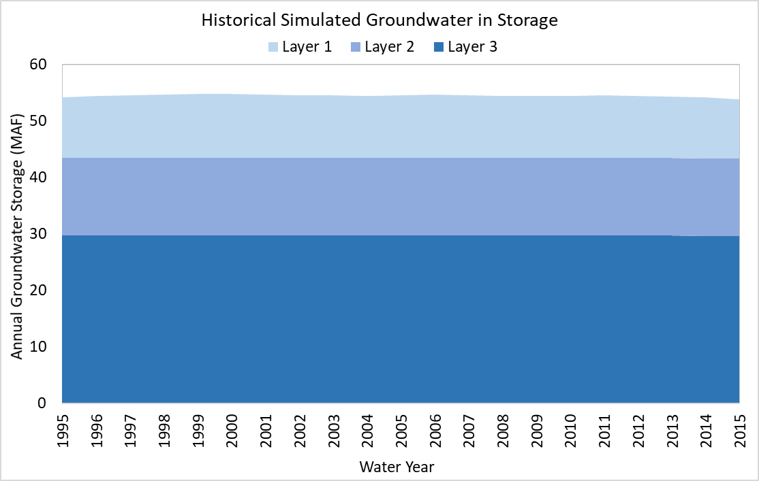
Reduction in Groundwater Storage
This graph shows freshwater only (model layers 1 through 3)
23

Slide 24
Minimum Thresholds for Sustainability Indicators
Chronic Lowering of Groundwater Levels
Reduction in Groundwater Storage
Seawater Intrusion
Degraded Water Quality
Land Subsidence
Depletion of Interconnected Surface Water
24

Slide 25
Seawater Intrusion
This Sustainability Indicator is not a concern for the Subbasin
Direct seawater intrusion does not occur in the Subbasin and thresholds do not need to be addressed. Salinity will be addressed via the Water Quality Sustainability Indicator.
25

Slide 26
Minimum Thresholds for Sustainability Indicators
Chronic Lowering of Groundwater Levels
Reduction in Groundwater Storage
Seawater Intrusion
Degraded Water Quality
Land Subsidence
Depletion of Interconnected Surface Water
26

Slide 27
Identified Undesirable Results for Water Quality
Salinity
Arsenic (naturally occurring)
Plumes
  1,2,3 TCP
Others?
27

Slide 28
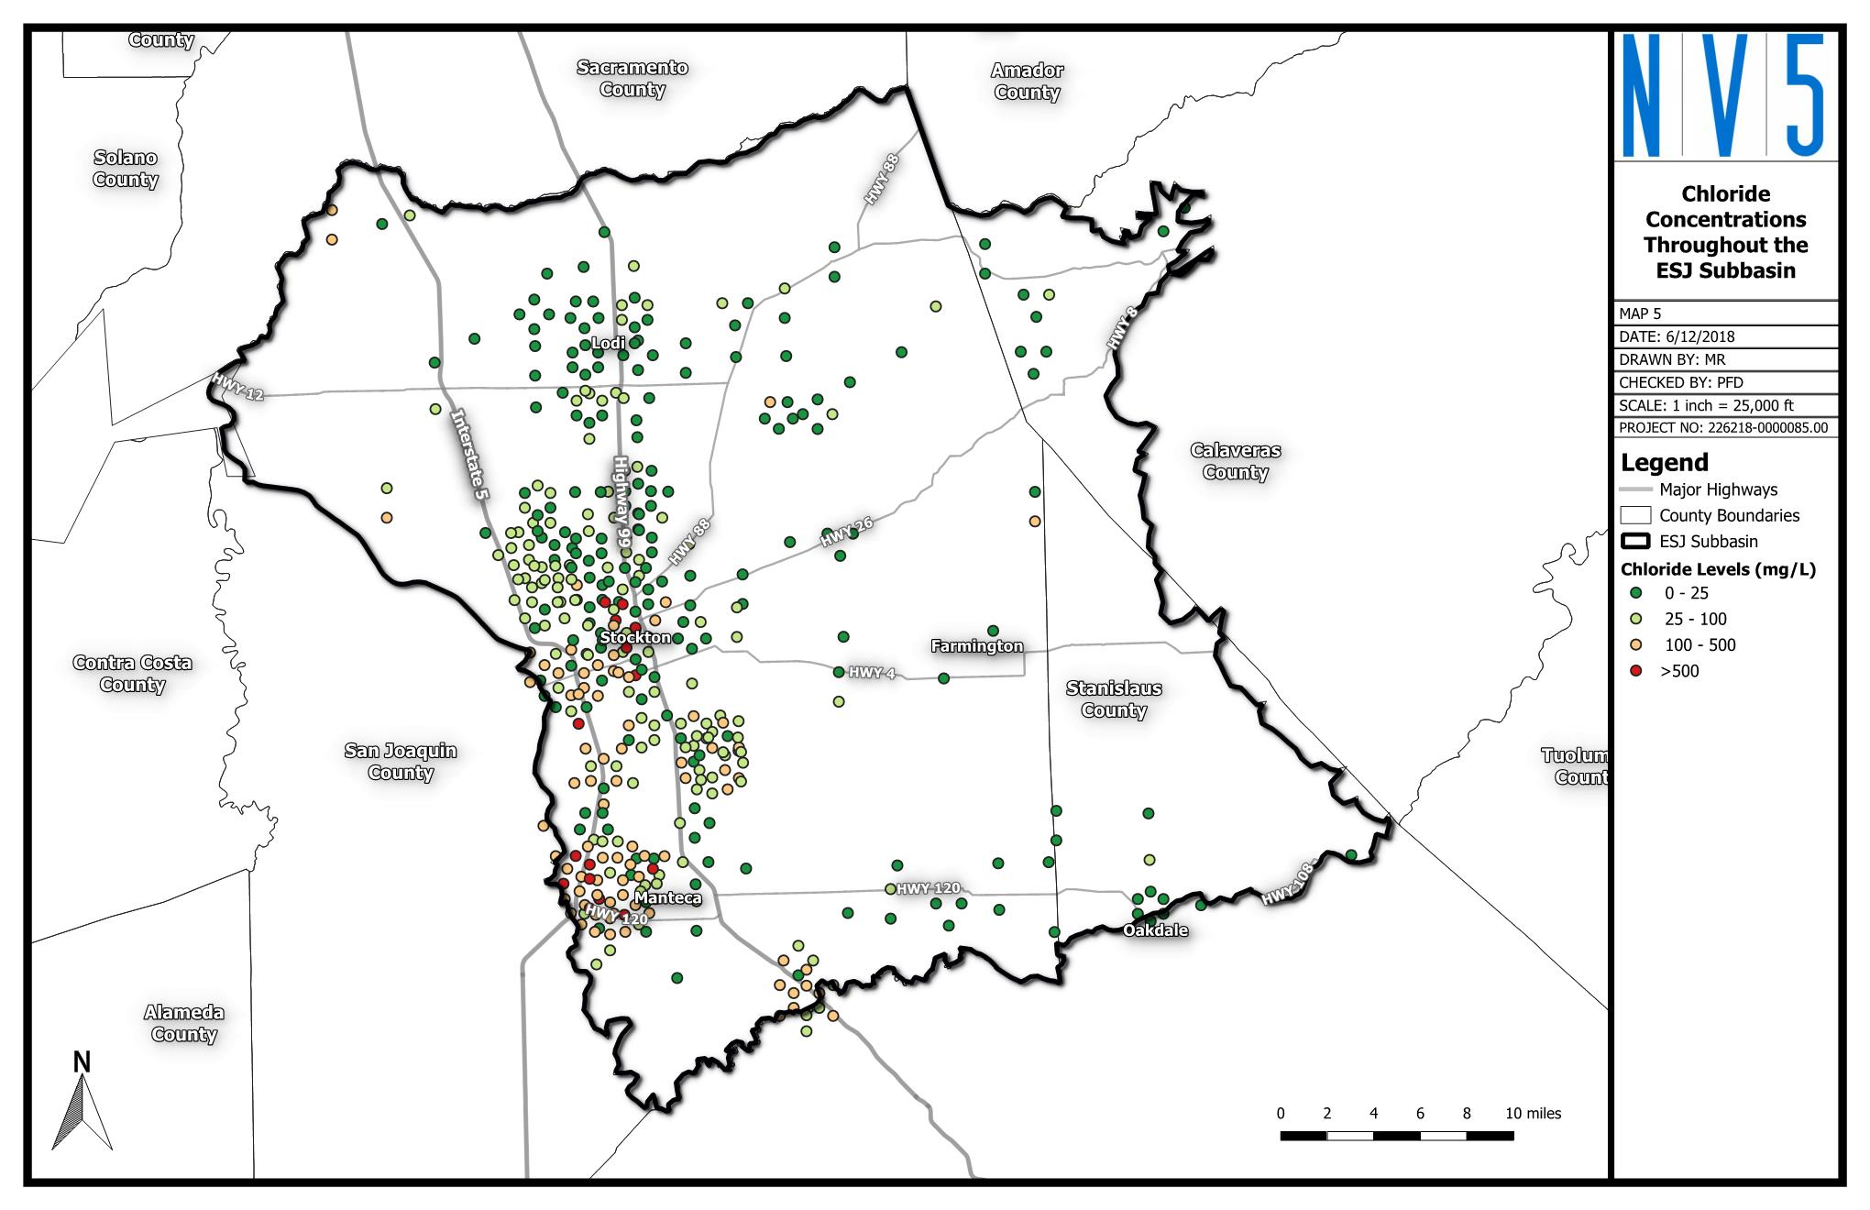
Prior Work Establishes Threshold as Halting Saline Intrusion Front
Identified Goal: Prevent further saline intrusion and degradation of groundwater quality throughout the Basin. (2004 ESJ Groundwater Management Plan)
28

Slide 29
Minimum Thresholds for Sustainability Indicators
Chronic Lowering of Groundwater Levels
Reduction in Groundwater Storage
Seawater Intrusion
Degraded Water Quality
Land Subsidence
Depletion of Interconnected Surface Water
To be presented at July 11, 2018 Advisory Committee
29

Slide 30
GSP Water Budget

Slide 31
Water Budget: Defining Time Frames
Current Conditions
Holds constant the most recent or “current” data on population, land use, year type, water supply and demand, and hydrologic conditions.
Future Conditions
Uses the future planning horizon to estimate population growth, land use changes, climate change, etc.
Historical
Uses historical information for hydrology, precipitation, water year type, water supply and demand, and land use going back a minimum of 10 years.
31

Slide 32
Future Conditions Baseline Assumptions
3 Main Components
1) Precipitation and Stream Inflow
2) Initial Conditions and Boundary Conditions
3) Urban Demand
    Projected populations are based on published planning documents
32

Slide 33
Approach to Projecting Supply and Demand
Step 1
Identify future demands through 2040
Step 2
Identify supply projects with yield and timing
Step 3
Develop supplies and demand from “current” (2015) to 2040
33

Slide 34
References Used to Develop Supply/Demand Projections
Agricultural Water Management Plans
Urban Water Management Plans
Groundwater Management Plans
Integrated Regional Water Management Plans
Data directly from GSAs
MokeWISE Water Availability Analysis
Capital Improvement Programs
General Plans
34
Notes:
Assume same cropping pattern into future
Urbanize based on GPs
Remove ag use from urbanized areas
Conversion of native land to active ag land is not included.
How is this process used?

Slide 35
DWR Technical Support Services Update

Slide 36

Technical Support Services (TSS) Update
The application process is underway.
The general application will be submitted in early July and we will move on to the monitoring well application
36

Slide 37
Next Up…
Hydrogeologic Conceptual Model Overview
Minimum Thresholds
Projected Water Budget
37

