Slide 1
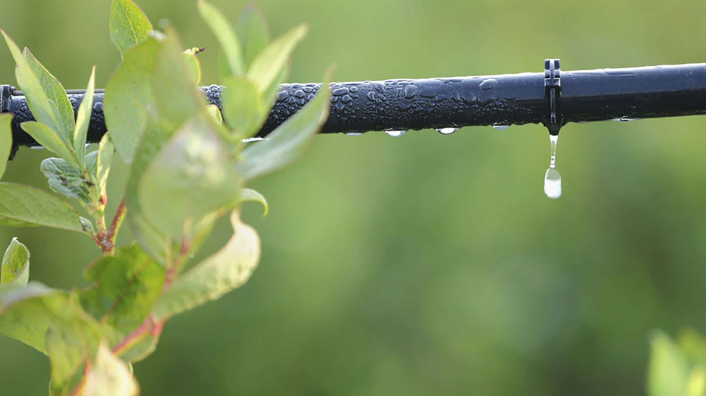
Materials for GSA Outreach August 2018

Slide 2
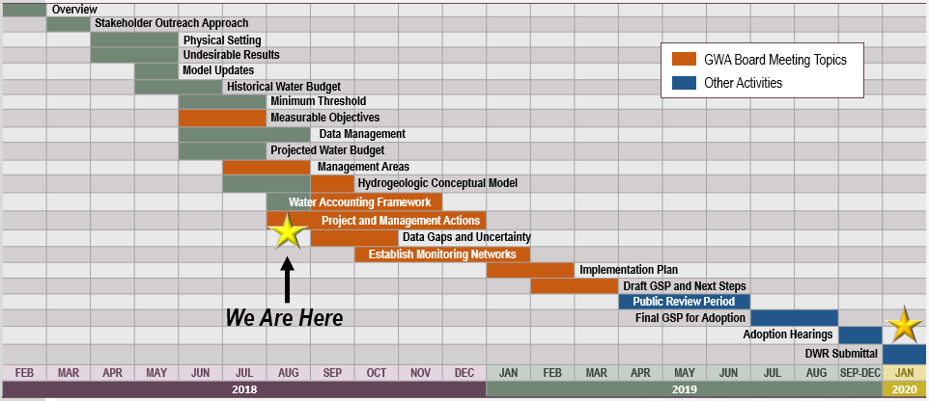
GSP Topics & Project Schedule
GSP Topics
GSP Finalization Elements
2

Slide 3
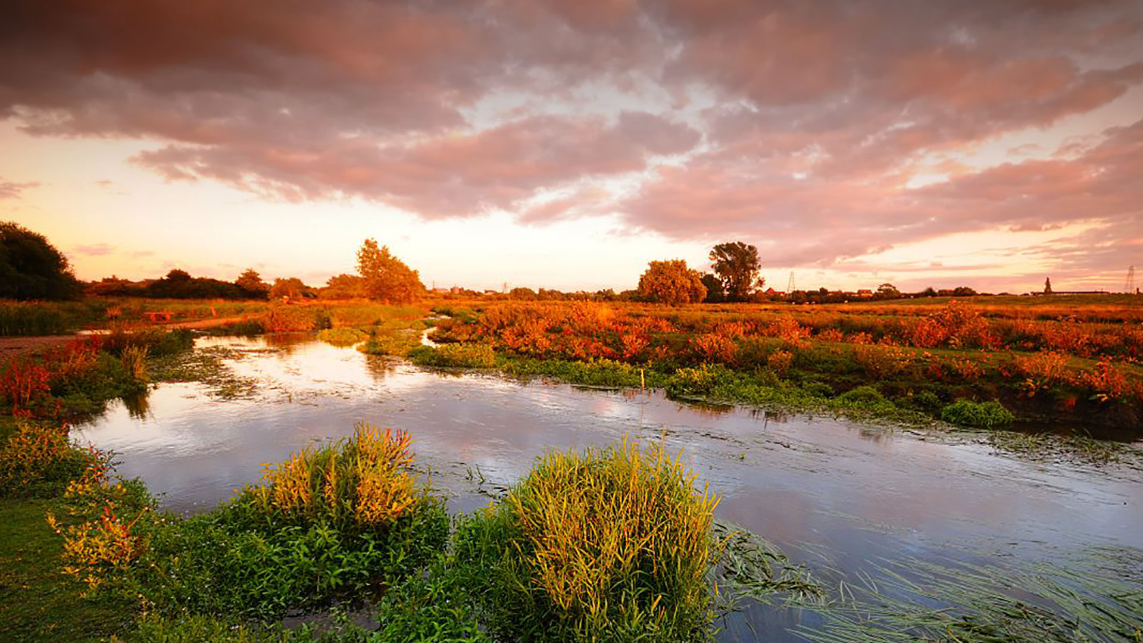
Outreach & Groundwater Sustainability Workgroup Update

Slide 4
Ways to Get Involved
Attend GW Sustainability Workgroup meetings as an observer
Participate in first Public Meeting (Open House: August 29, 2018 @ 6:30PM, Robert J. Cabral Agricultural Center)
Attend GWA Board or Advisory Committee meetings (monthly)
4

Slide 5
Ways to Stay Informed
Website:
Visit esjground water.org
Sign up for electronic updates at esjgroundwater.org
Watch for information from GSA, Advisory Committee and Workgroup members
Attend open-forum meetings
Request presentation to community group
5

Slide 6
Groundwater Sustainability Workgroup Update
6

Slide 7
GSP Update

Slide 8
Reminder – How do the Pieces Fit Together?
Document Potential Undesirable Results for Each Sustainability Indicator
Identify Appropriate Monitoring / Measurement Locations throughout Subbasin
Identify Spatially Representative Minimum Thresholds
Develop Measurable Objectives above Each Minimum Threshold
8

Slide 9
Reminder: Six Sustainability Indicators to be Addressed
Chronic lowering of groundwater levels indicating a significant and unreasonable depletion of supply
Significant and unreasonable degraded water quality
Significant and unreasonable reduction of groundwater storage
Depletions of interconnected surface water that have significant and unreasonable adverse impacts on beneficial uses of the surface water
Significant and unreasonable land subsidence
Significant and unreasonable seawater intrusion
9

Slide 10
Where are we now?
Document Potential Undesirable Results for Each Sustainability Indicator
Identify Appropriate Monitoring / Measurement Locations throughout Subbasin
Identify Spatially Representative Minimum Thresholds
Develop Measurable Objectives above Each Minimum Threshold
We are here
10

Slide 11
Major Plan Focus Areas
Working through Advisory Committee and Groundwater Sustainability Workgroup to:
Develop concept of what sustainability means for the Subbasin and identify high priority values around groundwater
Identify undesirable results occurring now or in the past
Develop minimum thresholds for each sustainability indicator
11

Slide 12
Sustainability Indicators Update
Progress has been made on approach for developing minimum thresholds all six sustainability indicators
Groundwater elevations will be the most important thresholds for the Subbasin – we started with those, and they will require the most work
Developed preliminary comparison of current and historical low groundwater elevations
Discussing undesirable results with GSAs and stakeholders to consider minimum thresholds to propose
Next steps: make refinements based on GDE information and subregional conditions
Reconcile varying thresholds across GSAs
12

Slide 13
Sustainability Indicators Discussed, cont’d.
Other Indicators:
Total Storage – no thresholds proposed
Seawater intrusion – no thresholds proposed
Water Quality – advisory committee considering potential approaches
Land Subsidence – advisory committee considering potential approaches
Depletion of Interconnected Surface Water – advisory committee considering potential approaches
13

Slide 14
Setting Minimum Thresholds (Continued)

Slide 15
Minimum Thresholds for Sustainability Indicators
Chronic Lowering of Groundwater Levels
Reduction in Groundwater Storage
Seawater Intrusion
Degraded Water Quality
Land Subsidence
Depletion of Interconnected Surface Water
15

Slide 16
Salinity Data Sources
Studies / Agencies with Salinity Data for ESJ:
USGS
2 studies (2005-6 & 2015)
Compilation of existing data and data from field tests
Focused on chloride concentrations
Data specific to ESJ subbasin
John Izbicki primary author for both studies
CV Salts
Compilation of existing state (i.e GeoTracker, USGS, etc.)
Focused on TDS & nitrate concentrations
Data for entire Central Valley
Luhdorff & Scalmanini and Larry Walker Associates compiled & analyzed statewide data in 2016
ILRP
Irrigated Lands Regulatory Program
Focused on concentrations of pesticides, toxicity, nutrients (including TDS + nitrates) in surface & groundwater
Growers biannually sample & submit data for irrigation and domestic wells (began in 2017)
San Joaquin County and Delta Water Quality Coalition Groundwater Quality Assessment Report, Hydrofocus, 2015
16

Slide 17
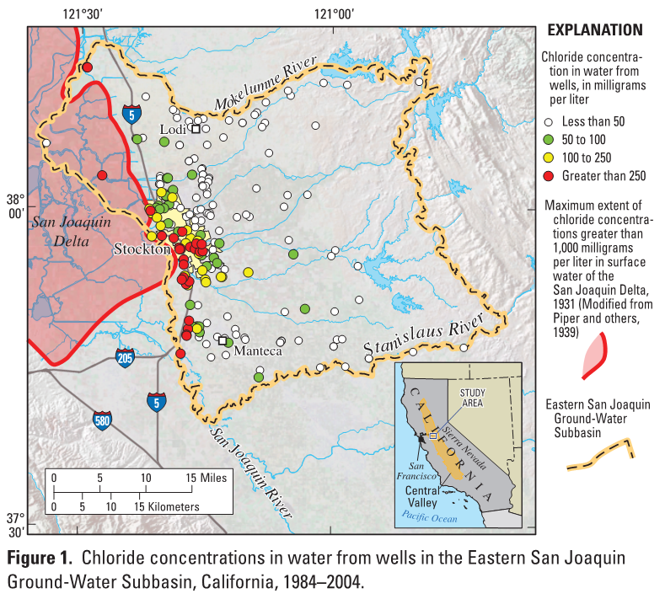
Chloride Concentrations in Groundwater 1984 - 2004
Highest chloride concentrations found near Stockton
(concentrations > 250 mg/L)
Source: O’Leary, Izbicki, and Metzger, 2015
17

Slide 18
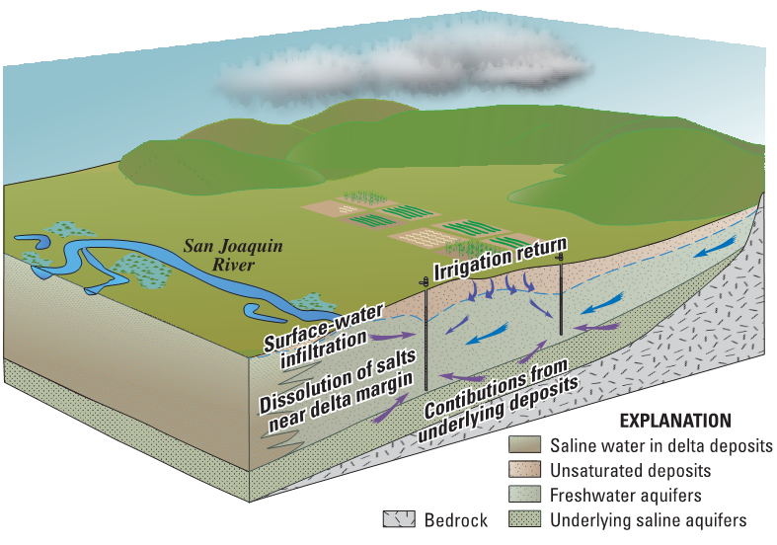
Sources of High-Chloride Water
3 Primary Sources :
High-Chloride Water from San Joaquin Delta Sediments (50% of wells in study)
High-Chloride Water from Deep Deposits (50% of wells in study)
Irrigation Return Water (16% of wells in study)
Source: Izbicki, et al. 2006
18

Slide 19
Water Quality Thresholds
Recognize existing management and regulatory programs
CVSALTs - SNMP for Central Valley includes proposed actions for salinity and nutrients
ILRP
Plumes (Cal/Federal EPA, Regional Board, DTSC)
Limit to nexus with management activities
Threat of upconing of deeper, saline water → covered under groundwater level thresholds
Control quality of recharge water
19

Slide 20
Minimum Thresholds for Sustainability Indicators
Chronic Lowering of Groundwater Levels
Reduction in Groundwater Storage
Seawater Intrusion
Degraded Water Quality
Land Subsidence
Depletion of Interconnected Surface Water
20

Slide 21
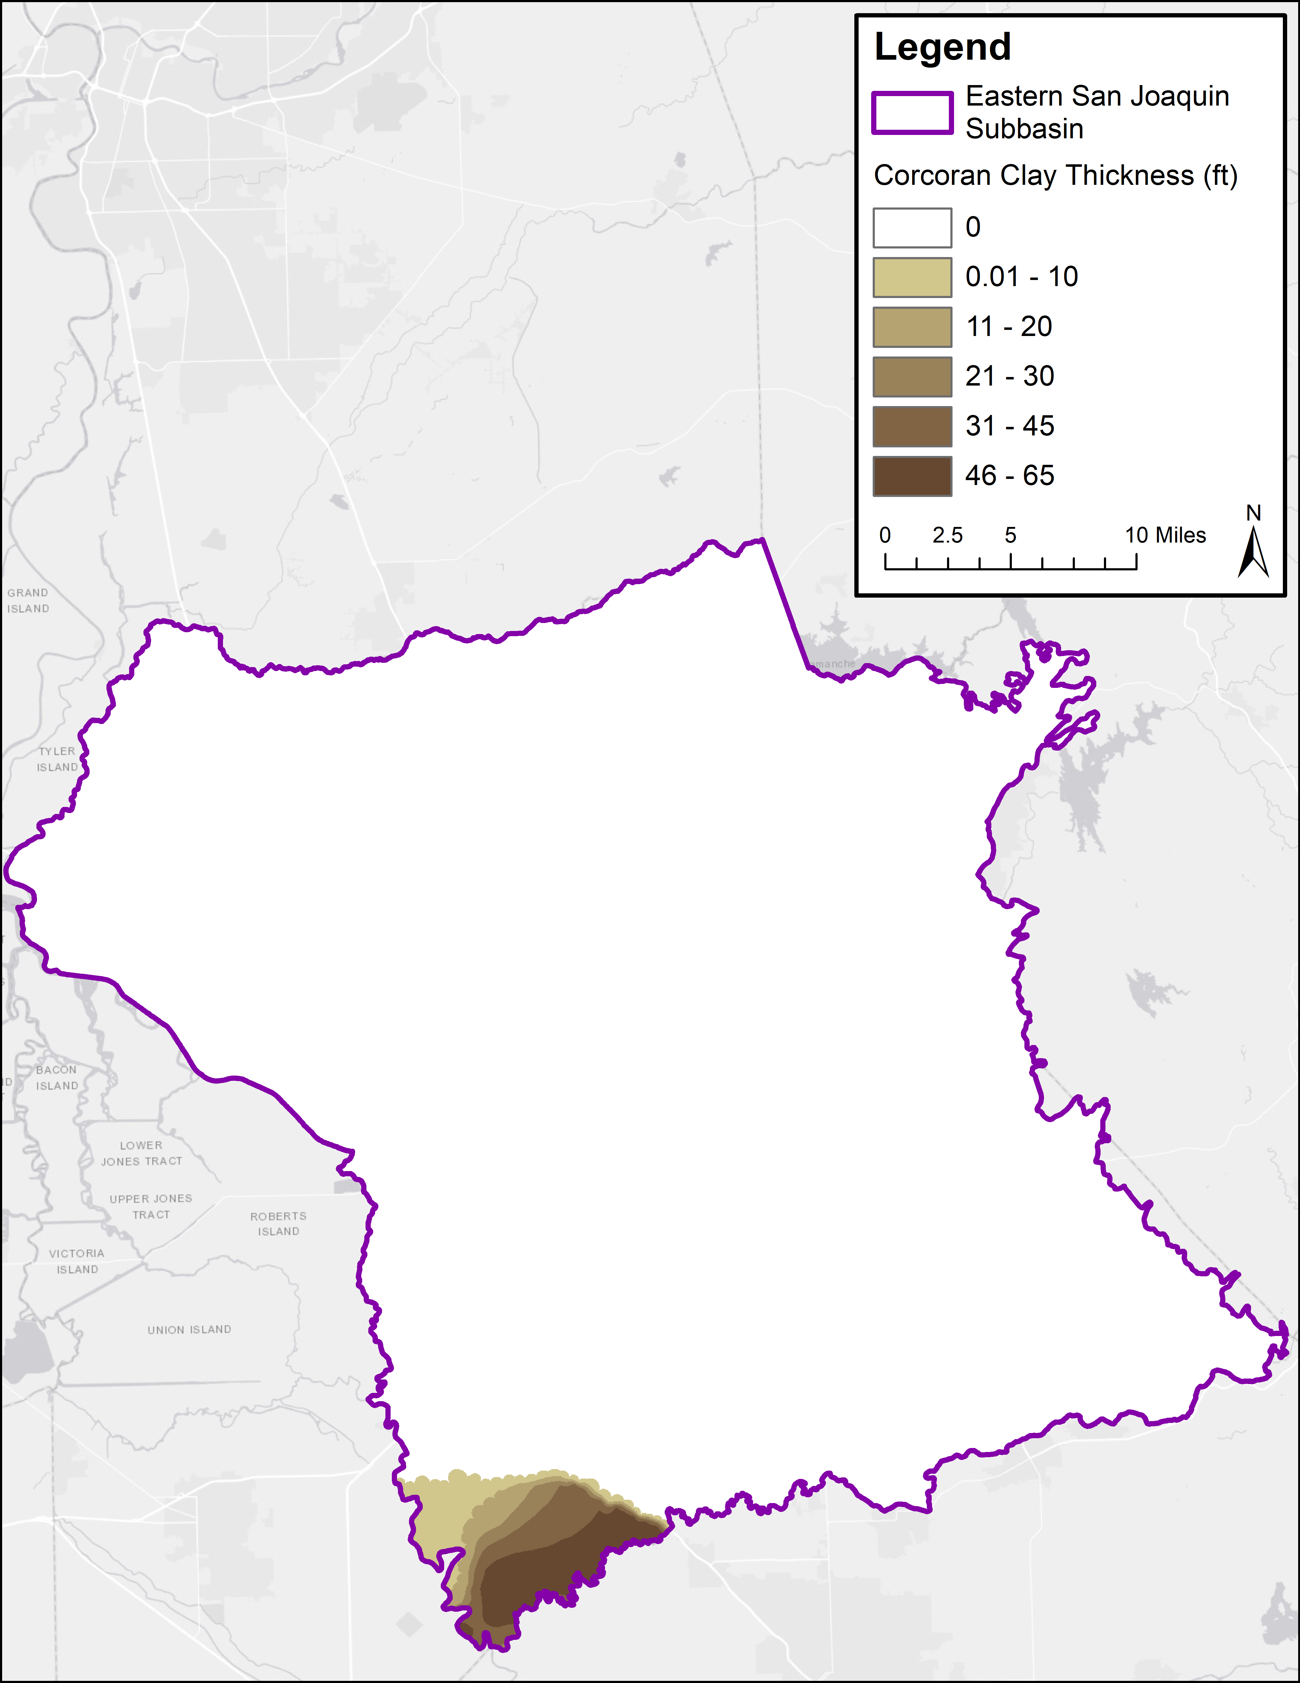
Setting Minimum Threshold for Subsidence
Potential for subsidence in area with Corcoran Clay – none observed historically, extent is limited, groundwater elevations in this area are typically high (proximity to surface water)
Data Source: USGS, by Page (1986), Central Valley Hydrogeologic Model
21

Slide 22
Setting Minimum Threshold for Subsidence
No Undesirable Results relating to Subsidence have occurred in the past
Minimum Thresholds for groundwater elevation (based on historical levels) are expected to be protective against subsidence
22

Slide 23
Minimum Thresholds for Sustainability Indicators
Chronic Lowering of Groundwater Levels
Reduction in Groundwater Storage
Seawater Intrusion
Degraded Water Quality
Land Subsidence
Depletion of Interconnected Surface Water
23

Slide 24
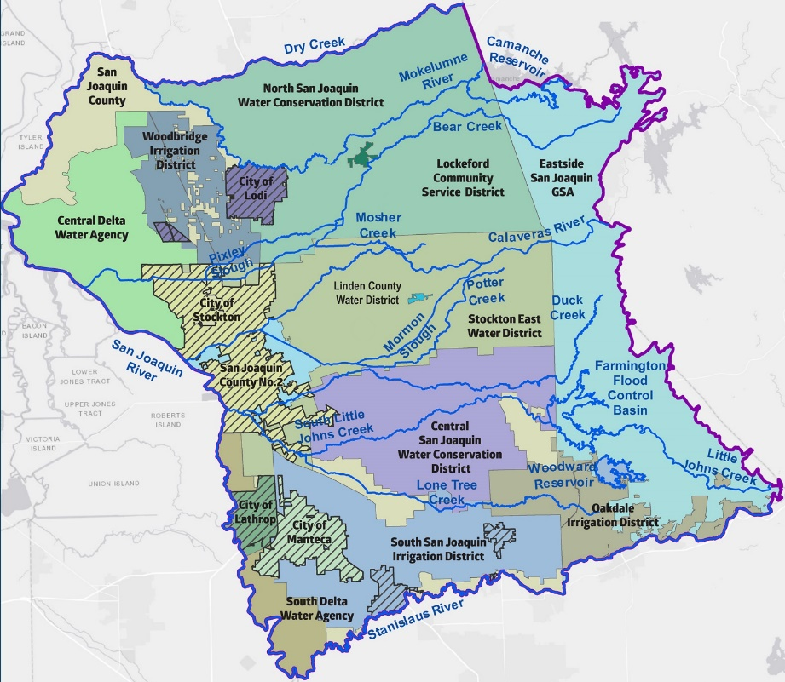
Setting Minimum Thresholds for Depletion of Interconnected Surface Water
Major river systems in the Subbasin are highly managed. Instream flow requirements, water quality standards, and water rights govern upstream releases.
24

Slide 25
Potential Minimum Threshold Approach
Recognize existing management and regulatory programs in place
Identify coordination and management activities that integrate with existing programs
25

Slide 26
Hydrogeologic Conceptual Model Overview
4

Slide 27
HCM Development – Basic Process
The process of creating cross sections and other HCM figures comprises 3 basic steps.
Wells and Logs
Obtaining well logs from various sources.
Comparing spatial distribution of wells for usefulness in HCM.
Examining Data
Documenting well log data, such as construction and lithological information.
Organizing data for use in GIS software and DMS.
Figure Generation
Producing cross sections and 3D figures of subsurface geology and groundwater conditions via GIS software.
27

Slide 28
DWR Technical Support Services Update

Slide 29
Technical Support Services Funding Update
The draft application has been submitted and approved by DWR!
Work is starting on a monitoring well installation task order.
29

Slide 30
Next Up…
Minimum Thresholds
GSP Development Update
Project Water Budget
Public Workshop
30

